Slide 1
Engineering Culture? Tools for Social Change
Sally Haslanger
9 May 2022
San Raffaele

Slide 2
Outline
Recap and Introduction
One Approach to Concepts (Conceptions, Orientations)
Forms of Conceptual Amelioration
Epistemic
Semantic
But…Isn’t Content Essential?
How Concepts Function in Social Systems
Conclusion

Slide 3
Outline
Recap and Introduction
One Approach to Concepts (Conceptions, Orientations)
Forms of Conceptual Amelioration
Epistemic
Semantic
But Isn’t Content Essential?
How Concepts Function in Social Systems
Conclusion

Slide 4
Language, Thought, and Politics
Much social change is triggered by natural disasters, wars, migration, pandemics, economic booms and busts.
Technology also produces social change (think of the automobile, the birth control pill).
But some occurs because the conceptual/symbolic frame for coordination changes. (And material and cultural change go hand in hand.)
What does the process of cultural change – a change in symbolic and conceptual resources – involve?
What are we doing when we come to understand that race is not a biological kind but a social construct? Do we change what it is to be married when we recognize same-sex marriage?
Have we replaced our old concept of marriage (race) with a new one?
Or has our understanding of marriage (race) simply evolved?

Slide 5
Activism and Backlash
It can be important for activists to insist that we are not simply undermining old practices and replacing them with new ones.
In the movement for marriage equality, same sex marriages are marriages as legitimate as any ever were.
We should also interpret history as continuous with our current conditions, e.g., race has been constructed over centuries with cultural tools that deflected attention from social reality; this is still happening today.
It is sometimes difficult, however, to defend the idea that we are not simply discarding our old ways and imposing something new. And contemporary philosophy can hinder us when it insists that our assumptions are analytic truths.

Slide 6
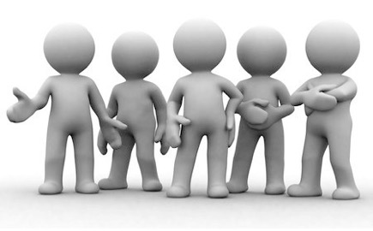
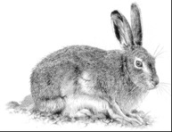
What is ”culture”? How do we change it?
I’ve argued for an account of culture as a set of tools – social meanings – that we employ as we engage in social practices.
Simple meanings (pink means girl, red means stop) and other forms of signaling (greeting rituals, clothing choices, logos);
Narrative tropes (“First comes love, then comes marriage, then comes baby in the baby carriage”) and material signals and prompts for one’s place in them (wedding rings);
Default assumptions (“Marriage is between one man and one woman”; Concepts (bachelor, marriage, sex, gender, race, water, justice) and alleged analytic truths about them);
Elements of architectural design
Heuristics
Familiar patterns of metaphor and metonymy
Entrenched conceptual homologies
Explicit public declarations
Internalization of schemas produce: filtering and shaping mechanisms
Cultural Technē/Ideology
Attitudes
Social Meanings
(Public)
Pet?
Food?
Pelt?
Leverage Points
PRACTICE
Resources
(things +/- valued)

Slide 7
Ideology and Amelioration
In response to oppression or injustice, we must (collectively) change the existing social structures, and this requires more than thinking differently.
However, today I will focus on the project of challenging a cultural technē, specifically the conceptual and symbolic tools it affords. One way of doing this is through conceptual engineering.
I’ve recently argued that one form of conceptual amelioration is epistemic, another is semantic. Here, I will review this distinction and argue that at least one form of semantic amelioration – amelioration on functional grounds – is coherent (and can be valuable).
[I won’t discuss how to distinguish an improvement as opposed to merely a change.]

Slide 8
Outline
Introduction: Language, Thought, and Politics
One Approach to Concepts (Conceptions, Orientations)
Forms of Conceptual Amelioration
Epistemic
Semantic
But Isn’t Content Essential?
How Concepts Function in Social Systems
Conclusion

Slide 9
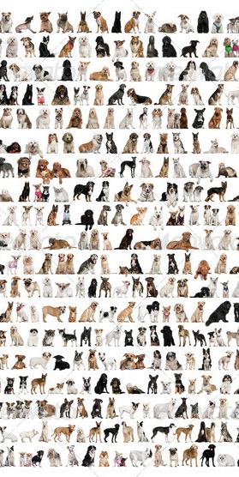
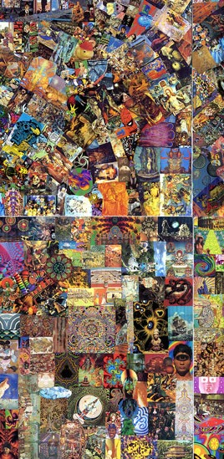
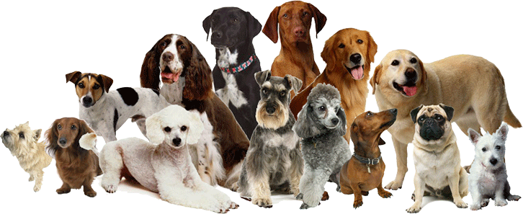
Concepts and Content
Possible
Dogs
Possible
Non-Dogs
But what are concepts, anyway? And how are they related to social meanings/ideology?
Externalism: the informational content of a concept is a partition of possible individuals.
A partition of possible dogs is just all the actual and possible dogs – the furry, slobbery, barky, ones in our lives, plus the ones that have existed, will exist, and ones we only imagine.
More specifically, the content of the concept is a partition of logical space. So the content of a concept Dog will be a function from a world (w₁, w₂, w₃) to a set of individuals in that world (dogs₁, dogs₂, dogs₃).

Slide 10
“Possessing” a Concept
Possible
Dogs
Possible
Non-Dogs
(Roughly), for an individual to possess (in the most minimal sense) a concept of X is to have a cluster of capacities that enables them to process information about Xs.
Possessing a concept is a matter of having dispositions towards a space of possibilia.

Slide 11
Concepts & Conceptions
We have access to partitions of logical space through different modalities, from different vantage points, and at different levels of granularity.
From a psychological point of view, possession of the concept may occur by virtue of different cognitive mechanisms and give rise to different dispositions in different individuals.
Conceptual skill comes in different forms and degrees.
Possible
Dogs
Possible Non-Dogs
We may share the concept of X – we both have the capacities the process information about Xs – but we differ in how refined or idiosyncratic our capacities are.
We can say, then, that different individuals who share the concept of X form different conceptions of X.

Slide 12
Standardization and being conversant
Individual conceptions of X will be idiosyncratic. But concepts are crucial, not just for thought, but also for communication and coordination.
Your capacities for attention, categorization, interpretation, memory, language, inference, affect, and the like, are marshalled for the purpose of coordinating (and refusing to coordinate) with others in response to information.
To be conversant with the concept of X in a context C one must be able to process a subset of information about Xs that is socially “approved” in C. (Putnam 1975: tiger, beech/elm).
Elm ↑ Beech →

Slide 13
Orientations
Those who are conversant with a concept in a context have an approved orientation that privileges certain exemplars, features, responses (affective and cognitive), experiences, inferences, sub-categories. (E.g., vet and child)
We sometimes introduce different words to pick out the same partition of logical space, e.g., vets might use the term ‘canis familiaris’ in certain contexts, reflecting the context of inquiry.
Water
H₂O
Yalcin makes this point with respect to the distinction between water and H₂O:
For example, the former [water] concept might (inter alia) be understood as embedding the partition into a subject matter reflecting parochial human interests and concerns, one including, say, the subject matter beverages— so that with the concept water, we (inter alia) locate that stuff amongst the beverages — while the latter [H₂O] embeds it in some part of the subject matter chemistry — so that with the concept H₂O, we inter alia locate that stuff amongst the chemicals. (15)
The subject matter is plausibly delimited by a set of questions that arise in inquiry,
but also in relation to our practical concerns.

Slide 14
Conceptual Fluency
If we want to reify an orientation, it might be thought of as a temporally extended abstract particular that is the evolving cluster of socially approved (epistemic/affective/agential) responses to some privileged subset of information. (Rituals?)
The veterinary orientation privileges the distinction between sick and healthy non-human animals and requires epistemic and affective responses that guide the exercise of agency.
Fluency in an orientation can also involve being conversant with a broad range of signaling mechanisms and social meanings employed in the context.
The concept pink has the color pink as its informational content. But to be conversant with pink in some contemporary contexts requires responses linked to femininity, the use of feminine pronouns, etc.
My focus will on concepts, understood as a public resource for coordination, so on orientations rather than individual conceptions.

Slide 15
Outline
Introduction: Language, Thought, and Politics
One Approach to Concepts (Conceptions, Orientations)
Forms of Conceptual Amelioration
Epistemic
Semantic
But Isn’t Content Essential?
How Concepts Function in Social Systems
Conclusion

Slide 16
Epistemic Amelioration
We improve our understanding of the informational content.
Refinement: We refine our concept based on a broader or deeper knowledge of the phenomenon, e.g., by gaining empirical knowledge, undertaking conceptual genealogy, and/or developing insight into logical space at a more fine-grained resolution.
Experiential access: We improve our access the informational content, gaining more reliable or illuminating access by different modes of presentation.

Slide 17
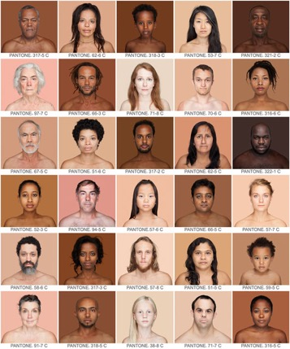
Informational/Semantic Amelioration
We change what partition of logical space the term/concept represents.
Alethic: We improve the resources available to track truths, e.g., discovering ‘race’ is a socio-historical kind.
Whites
Non-Whites
Pragmatic: What we mean can affect what we do, so what there is to track. Changing the terms of coordination may be practical, and call for re-figuring social space, e.g., lunch, marriage, piety.
Moral: Our concepts can affect our moral orientation, what is morally salient, so may require change.

Slide 18
Outline
Introduction: Language, Thought, and Politics
One Approach to Concepts (Conceptions, Orientations)
Forms of Conceptual Amelioration
Epistemic
Semantic
But Isn’t Content Essential?
How Concepts Function in Social Systems
Conclusion

Slide 19
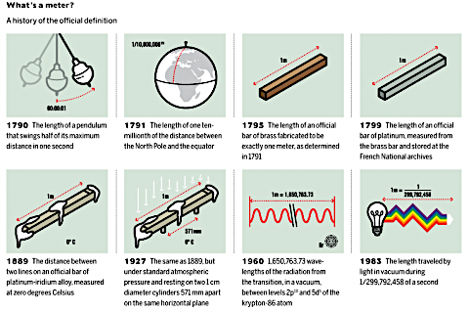
How is semantic amelioration possible?
If informational content is essential to a concept, then semantic amelioration is impossible, and the best we could hope for is concept replacement.
Concept replacement is compatible with retaining the word for the new content, so replacement could be masked. But can the content of a concept change, while it remains the same concept?
Concepts provide us with orientations towards logical space – they should be dispositions that are apt for the content, and apt for the function they serve in coordination.
Consider the meter….

Slide 20
Why Bother with Concepts?
Concepts are not simply cognitive placeholders for content; they provide orientations toward content at different levels of granularity, highlight features of the content in response to questions, situate the content in different subject matters, and mandate a cluster of (inferential and affective) responses. So these aspects of concepts should carry weight in individuation.
It is sometimes more important to the individuation of a concept that it be included in a particular subject matter and embedded in the relevant set of practices (Yalcin on water and H₂O), than that it maintain its exact informational content. In these cases, we should say that a change of content is compatible with the continuity of concept.

Slide 21
Content and Subject Matter (Yalcin)
H₂O
Beverages
Water
Water
H₂O
Beverages
Chemicals
Chemicals

Slide 22
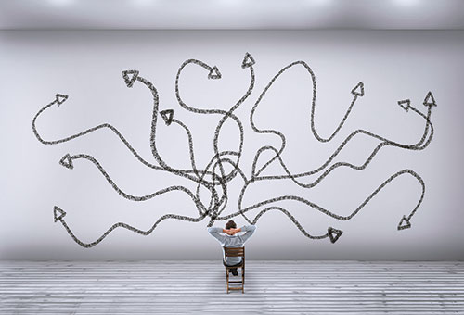
Looking for a rule?
The very point of introducing concepts (over and above meanings) is to do justice to the different ways we access content and our different dispositions to respond to content. To ignore these differences in considering the individuation of concepts would be to sacrifice what we have gained.
I am not going to propose an algorithm to guide us in deciding when and how to ameliorate. These decisions are a matter of judgment and are sensitive to a broad range of considerations (Williamson 2007, Railton 2014). We encounter them not just as theorists, but as agents engaged in historically specific practices.
The question is how should we go on, and there is no rule to tell us how.

Slide 23
Outline
Introduction: Language, Thought, and Politics
One Approach to Concepts (Conceptions, Orientations)
Forms of Conceptual Amelioration
Epistemic
Semantic
But Isn’t Content Essential?
How Concepts Function in Social Systems
Conclusion

Slide 24
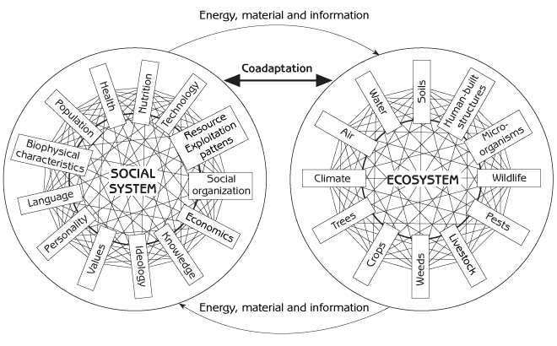
Systems Approach to Functions
In some cases of amelioration, we should look to the function of a concept to determine how to proceed: What function does this concept serve?
I am not claiming that we construct concepts with purposes in mind or that concepts have a “proper function.” This is not teleosemantics. I am relying on a systems conception of function, rather than a purposive or etiological conception.
According to a systems approach, features of a system (engine, circulatory system) are explained, in part, by the interactions between its sub-parts (carburetor, heart).
We decide on what system and what features of the system we are interested in. The same thing can function differently with respect to different systems. (Remember the school functioning in different systems.)

Slide 25
Families
Functional: because we process certain kinds of information mainly for the purpose of coordination, we can judge the adequacy how we do so by reference to how well the coordination works.
Better and worse concepts of family can be evaluated in terms of how having the relevant dispositions to respond to a particular content enables us to achieve coordination, e.g., around intimacy, childrearing, economic collaboration.
Sometimes epistemic amelioration is not enough, we need to modify the content, e.g., to include same-sex or adoptive families.
Moral: the organization of family life is a matter of justice.
Should we count as real families only constituted by heterosexual couples and their biological offspring?
Our concept of family can be evaluated with respect whether it facilitates coordination on morally acceptable terms.

Slide 26
Amelioration
Note that the partition of logical space that we should be collectively tracking, and how we track it, may be very different from the one we are currently tracking.
This provides a basis for allowing ameliorative accounts to be a way of improving the content of our concepts, and not just replacing them.
Concepts/orientations are part of the cultural technē that keep a social system running because they focus our attention on features of the world around which we coordinate and call for “approved” responses.
Changing the options for how we experience and respond to the world, we can change our practices.

Slide 27
Implementation?
On what basis are we entitled to override previous understandings of the content, or the requirements for the orientation?
We rely on a principle of charity – what (forgivable) errors were likely, given the circumstances; what objectives seemed reasonable at the time; how the world might have changed.
This does not avoid all conflict. Sometimes the attempt at change fails. But other times we win.😄
The “implementation problem” (Cappelen): Engineers cannot change how people use words, so even if we come up with a great idea in the seminar room, it doesn’t matter.
This criticism misunderstands the project. Engineers of the sort I have in mind are embedded in social movements and are aiming, through a wide range of activities, to change our perspective – perhaps to prompt a paradigm shift.
If we are urging a change of practices and a corresponding shift in our dispositions to respond to partitions of logical space, then highlighting phenomena that might have been obscured, distorted, or considered irrelevant (by ideology) can shift our dispositions to be more inclusive/exclusive. And this is all we really need.

Slide 28
Outline
Introduction: Language, Thought, and Politics
One Approach to Concepts (Conceptions, Orientations)
Forms of Conceptual Amelioration
Epistemic
Semantic
But Isn’t Content Essential?
How Concepts Function in Social Systems
Conclusion

Slide 29
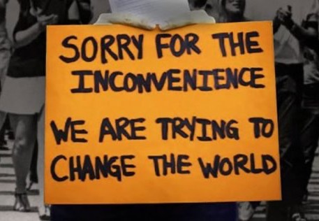
Conclusion
We have an interest in carving logical space in order to coordinate with each other, to draw distinctions that serve our purposes as social beings and to realize our values. How best to do this changes as we develop new technologies and as we come to appreciate new and different values.
When social change happens, there is likely to be controversy and disagreement about how to extend the concepts we’ve been using to do the work we now need them to do. Such changes should be acknowledged as such, and should not be held hostage to what we have thought we were doing all along, and how to continue that.
Our conceptual frameworks should be forward-looking and give us the tools to envision and create better lives together.

Slide 30
Thanks for your attention!

