Slide 1
What is Social Meaning? The Power of Signals
Sally Haslanger
8 June 2022

Slide 2
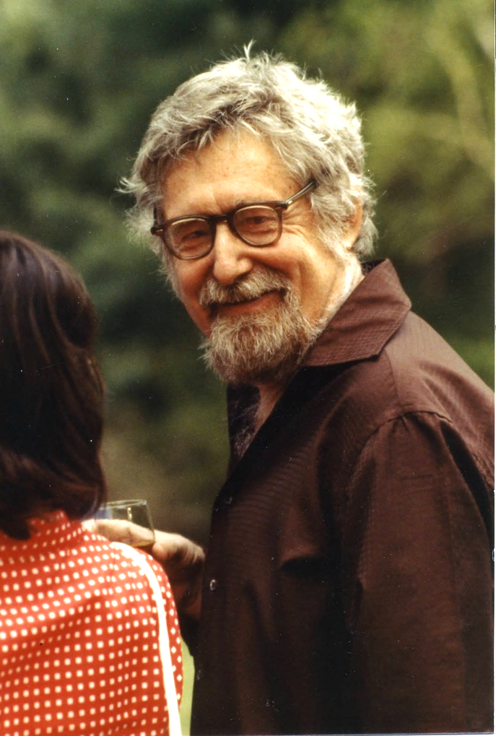
To undertake the study of cultural activity – activity in which symbolism forms the positive content – is thus not to abandon social analysis for a Platonic cave of shadows, to enter into a mentalistic world of introspective psychology or, worse, speculative philosophy, and wander there forever in a haze of “Cognitions,” “Affections,” “Conations,” and other elusive entities. Cultural acts, the construction, apprehension, and utilization of symbolic forms, are social events like any other; they are as public as marriage and as observable as agriculture.
(Clifford Geertz “Religion as a Cultural System,” 91).

Slide 3
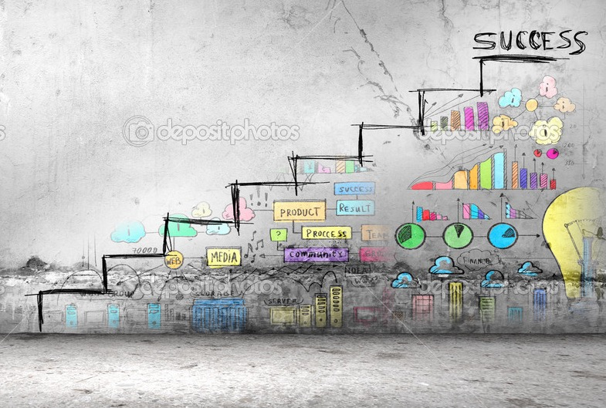
Outline
Recap and Introduction
Psychological and Materialist Approaches
Signaling and Content
Uptake in Practices
Conclusion

Slide 4
Outline
Recap and Introduction
Psychological and Materialist Approaches
Signaling and Content
Uptake in Practices
Conclusion

Slide 5
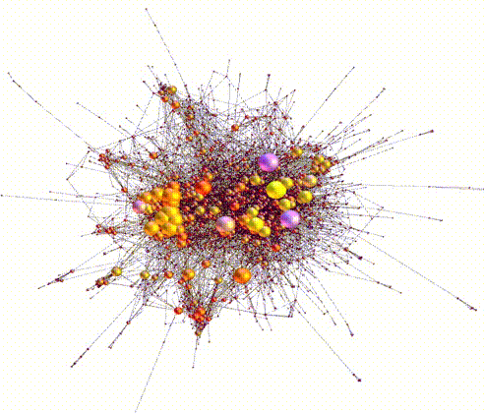
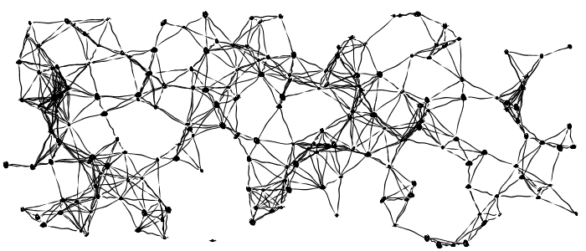
Recap
What is systemic oppression and why is it so hard to displace?
Why do we enact it, even though we oppose it?
Return to our broad questions:
I suggested before that societies are complex systems that are structured by networks of relations that are established in social practices.

Slide 6
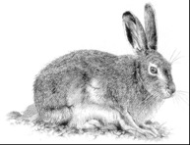
Practices
Internalization of schemas produce: filtering and shaping mechanisms
Social practices are
patterns of learned behavior that, at least in the primary instances,
enable us to coordinate as members of a group in creating, distributing, using managing, maintaining, and discarding a resource (or multiple resources),
due to mutual responsiveness to each other’s behavior and the resource(s) in question,
as interpreted through shared meanings/cultural schemas (a cultural technē).
Cultural Technē/Ideology
Attitudes
Social Meanings
(Public)
Pet?
Food?
Pelt?
PRACTICE
Resources
(things +/- valued)

Slide 7
Sources of injustice/oppression
One source: Our cultural technē masks or distorts our understanding of social reality and/or organizes us in wrongful/harmful ways.
Internalization of schemas produce: filtering and shaping mechanisms
Cultural Technē/Ideology
Cultural Technē/Ideology
Attitudes
Another source: We have shaped our material conditions so that they are extremely difficult or costly to change.
Social Meanings
(Public)
Social Meanings
(Public)
Driving scripts, values
Pet?
Food?
Pelt?
PRACTICE
PRACTICE
Resources
(things +/- valued)
Resources
(things +/- valued)

Slide 8
Culture
The term ‘culture’ is controversial and has many different uses. The term ‘ideology’ is no better.
So where should we begin?
It is “the framework of meanings and values within which people exist and conduct their social lives” (479).
…human individuals participate in forms of understanding, comprehension or consciousness of the relations and activities in which they are involved…This consciousness is borne through language and other systems of signs, it is transmitted between people and institutions and, perhaps most important of all, it makes a difference; [it] has consequences for the direction and character of their action and inaction. (Purvis & Hunt 1993, 474)
Culture guides action; it is a ”practical consciousness.”
It can be implicit or explicit (so it may not be “conscious” in the ordinary sense).
It is a “perspective” that helps us communicate and coordinate.
It does so by shaping what we notice, remember, value, etc.

Slide 9
Sociological and Critical Traditions
NOTE: I’m not going to provide a normative theory of justice/injustice today.
There are two important traditions in theorizing ideology.
Sociological Tradition: All social groups have an ideology in the sense described. An ideology is a cultural frame for interaction. Some ideologies are good and some are bad, i.e., some support oppressive social arrangements and some don’t.
This tradition employs the term ‘ideology’ in a non-pejorative or neutral sense.
Critical Tradition: All social groups need a cultural frame for interaction (as the sociological tradition says). But not all cultural frames are ideological – a cultural frame is ideological to the extent that it shapes our interactions so that they perpetuate domination and subordination.
This tradition employs the term ‘ideology’ in the pejorative sense.
I situate myself in the critical tradition and will use the term in the pejorative sense.

Slide 10
Should we conclude that culture/ideology consists of psychological states?
An ideology is a widely held set of loosely associated beliefs and implicit judgments that misrepresent significant social realities and that function, through this distortion, to bring about or perpetuate unjust social relations (66; his italics).
Yet, in his “Ideology and Ideological State Apparatuses,” (1971/2014) Louis Althusser asserts:
“Thesis II: Ideology has a material existence.”
He elaborates the thesis later:
“I now return to this thesis: an ideology always exists in an apparatus, and its practice, or practices. This existence is material”

Slide 11
Cultural technē: What’s Included?
Simple meanings (pink means girl, red means stop) and other forms of signaling (greeting rituals, clothing choices, logos);
Narrative tropes (“First comes love, then comes marriage, then comes baby in the baby carriage”) and material signals and prompts for one’s place in them (wedding rings, “gender reveal” events and associated paraphernalia);
Default assumptions (“Marriage is between one man and one woman” “The US Constitution protects liberty and justice for all.”); Concepts (bachelor, marriage, sex, gender, race, water, justice) and alleged analytic truths about them);
Elements of architectural design (brick and ivy, toilets designated for men and women only, spaces only accessible by stairs, facade columns);
Heuristics (imitate-the-majority, or imitate-the-successful;
Familiar patterns of metaphor and metonymy (“God is love,” “The pen is mightier than the sword”);
Entrenched conceptual homologies (reason : passion :: man : woman);
Explicit public declarations (“Black Lives Matter,” “Blue Lives Matter”).

Slide 12
I understand a materialist account as one that considers phenomena of "consciousness" - e.g., intellectual production, broad social attitudes and beliefs, cultural myths, symbols, images, etc. - as rooted in real social relationships.
This should not imply "reducing" such phenomena of consciousness to social structures and social relationships, nor does it even mean that the phenomena of consciousness cannot be treated as having a logic of their own.
Nor should it mean that phenomena like attitudes and cultural definitions cannot enter as elements into the explanation of a particular structure of social relationships, though I would claim that they can never be the sole explanation.
This requirement mainly calls for a methodological priority to concrete social institutions and practices along with the material conditions in which they take place.
(Iris Young 1980/1990, 33 – my italics)

Slide 13
Questions
1) What exactly are the constituents of a cultural technē? Is it psychological? Material? Both? Neither? Is there a coherent ontology?
2) There are many possible cultural technēs that could manage coordination of a group. What does it mean to say that a cultural technē is ours? What determines whether it is ours?
3) How does a cultural technē manage us? In particular, how does an ideological technē manage us, given that it is typically false or misleading and produces unjust or harmful social stratification?
4) What is it for a group to “take up” a cultural technē or for an individual to be “in the grip” of an ideology?

Slide 14
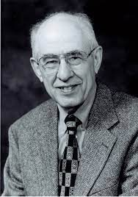
The claims I will aim to make plausible today
A psychological approach to cultural technē/ideology is inadequate.
Social meanings, like linguistic meanings, ”aren’t in the head,” though they are taken up in developing social ”know how”.
This is in keeping with a broad content-externalism.
Hilary Putnam
Robert Stalnaker
Tyler Burge

Slide 15
Outline
Recap and Introduction
Psychological and Materialist Approaches
Signaling and Content
Uptake in Practices
Conclusion

Slide 16
Psychological Approach
Recall our starting point:
…human individuals participate in forms of understanding, comprehension or consciousness of the relations and activities in which they are involved…
It is “the framework of meanings and values within which people exist and conduct their social lives.”
(Purvis & Hunt 1993, 474, 479)
How could culture, then, not be psychological?
Meanings and values are determined by what we believe, want, and care about.
Our coordination, moreover, seems to be guided by a kind of “collective intentionality” that drives joint action.
We invoke meanings and values to explain and rationalize behavior.

Slide 17
Questions
1) What exactly are the constituents of a cultural technē? Is it psychological? Material? Both? Neither? Is there a coherent ontology?
Suppose a cultural technē is psychological (a set of beliefs?)….
2) There are many possible cultural technēs that could manage coordination of a group. What does it mean to say that a cultural technē is ours? What determines whether it is ours?
3) How does a cultural technē manage us? In particular, how does an ideological technē manage us, given that it is typically false or misleading and produces unjust or harmful social stratification?
4) What is it for a group to “take up” a cultural technē or for an individual to be “in the grip” of an ideology?

Slide 18
How Does a Cultural Technē Work?
Content Determination: Our cultural technē has as its content the framework of meanings and values F because that content F is believed by the majority/the dominant.
Dominant Entrenchment: A cultural technē has the power to produce and/or stabilize unjust social stratification because the dominant believe it, i.e., the dominant rely on ideology to enforce or entrench such stratification.
(“Dominant” might be replaced with ”Widespread”?)

Slide 19
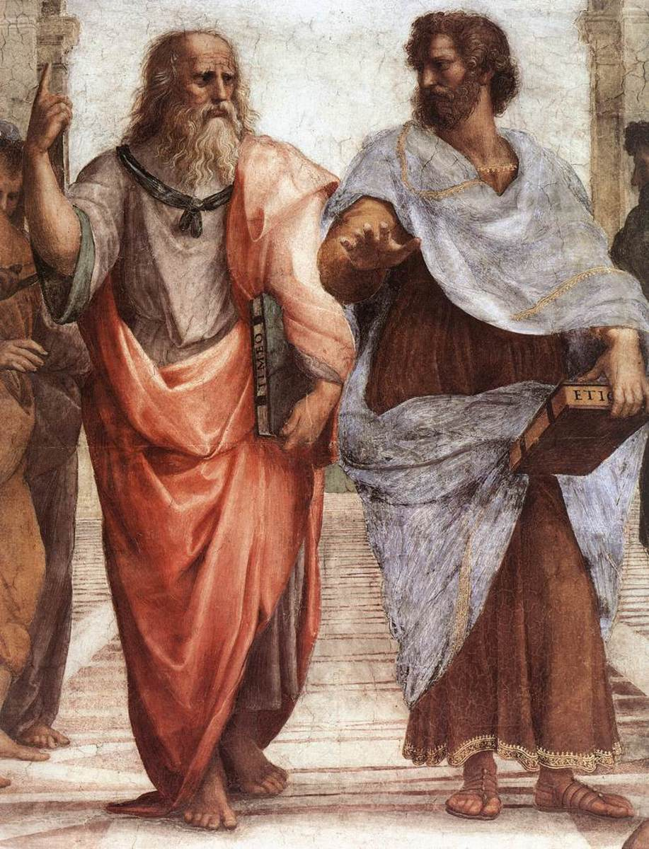
Euthyphro Redux
If the content of our technē is determined by the majority/dominant, can the majority/dominant be corrected about the content? Does what they believe constitute the ideology until they decide otherwise?
This just pushes the question back: why do the majority/dominant believe that women are inferior to men, that people of color are inferior to Whites, etc.?
What explains the content, especially if the propositions included in it are systematically false or misleading, as ideology often is?

Slide 20
Hysteria (Kapsalis 2017)
The uterus was believed to wander around the body like an animal, hungry for semen. If it wandered the wrong direction and made its way to the throat there would be choking, coughing or loss of voice, if it got stuck in the rib cage, there would be chest pain or shortness of breath, and so on. Most any symptom that belonged to a female body could be attributed to that wandering uterus.
Even in the 20th century, [s]cores of white women artists and writers were diagnosed as hysterics in a period when rebelliousness, shamelessness, ambition, and “over education” were considered to be likely causes. Too much energy going up to the brain instead of staying in the reproductive organs and helping the female body do what it was supposed to do.
By the 19th century, [i]t was believed that hysteria, also known as neurasthenia, could be set off by a plethora of bad habits including reading novels (which caused erotic fantasies), masturbation, and homosexual or bisexual tendencies resulting in any number of symptoms such as seductive behaviors, contractures, functional paralysis, irrationality, and general troublemaking of various kinds.

Slide 21
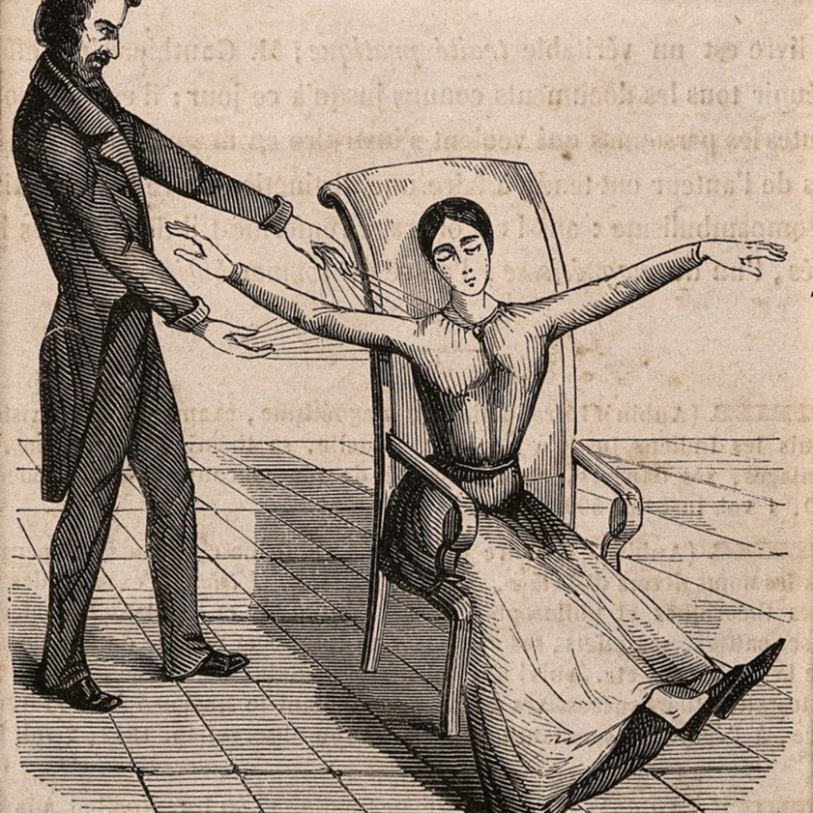
The Function of Ideology
Reflecting on their evolution, attitudes about hysteria [racial inferiority, etc.] don’t seem to be determined by what the dominant or the majority believe, but by what might plausibly keep women [people of color, etc. ] in their place, given the current medical knowledge and political circumstances.
The dominant (or the majority) shift their attitudes when they stop serving the stabilizing social function; in the case of ideology, when they fail to maintain social stratification. So the content determination claim is false.
Notes:
The uterus was believed to wander around the body like an animal, hungry for semen. If it
wandered the wrong direction and made its way to the throat there would be choking, coughing
or loss of voice, if it got stuck in the rib cage, there would be chest pain or shortness of breath, and
so on. Most any symptom that belonged to a female body could be attributed to that wandering
uterus. (Kapsalis 2017)
The belief that hysteria was caused by a wandering uterus was eventually rejected, but the idea that
hysteria was a feminine malady was not. By the 19th century,
[i]t was believed that hysteria, also known as neurasthenia, could be set off by a plethora of bad
habits including reading novels (which caused erotic fantasies), masturbation, and homosexual or
bisexual tendencies resulting in any number of symptoms such as seductive behaviors,
contractures, functional paralysis, irrationality, and general troublemaking of various
kinds. (Kapsalis 2017)
Even in the 20th century,
[s]cores of white women artists and writers were diagnosed as hysterics in a period when
rebelliousness, shamelessness, ambition, and “over education” were considered to be likely causes.
Too much energy going up to the brain instead of staying in the reproductive organs and helping
the female body do what it was supposed to do. (Kapsalis 2017)

Slide 22
What about Entrenchment?
Dominant Entrenchment: the best explanation of unjust social stratification is that the dominant believe the ideology and rely on it to enforce or entrench such stratification.
Dominant belief is not necessary for ideology to be effective. For example, in the example of hysteria, there is no reason to think that it is especially important for the dominant (men) to believe in women’s hysterical tendencies, as long as those who are supposed to adopt the role (women) believe it of themselves.
Widespread belief is not necessary either; even if we all disbelieve the ideology, we may conform to it because we (mistakenly) believe that others believe it.
Moreover, ideology it may gain power by being materially entrenched.

Slide 23
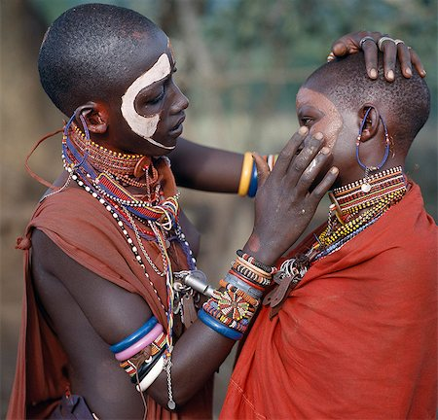
“Living in” ideology
In speaking of ideology, it is common to suggest that individuals live within a social world of meanings and values. The idea that we “live in” ideology suggests two things:
First, ideology is somehow, or to some extent, “prior” to our (epistemic, social) agency; belief and action takes place against the backdrop of social meaning.
Second, we are shaped by the ideology to fit within it.
People become people [social subjects] only when they enter into culture, which is to say, only when culture enters into them, and becomes them, when they are programmed with and hence constituted by tools of understanding created by a culture at a certain point in history. Through existence in history, which is existence in culture, people obtain and incorporate cultural tools, and these become as much a part of them as their arms and legs. (Balkin 1998, 18)

Slide 24
Questions
1) What exactly are the constituents of a cultural technē? Is it psychological? Material? Both? Neither? Is there a coherent ontology?
2) There are many possible cultural technēs that could manage coordination of a group. What does it mean to say that a cultural technē is ours? What determines whether it is ours?
The content of a technē is determined by how it functions.
3) How does a cultural technē manage us? In particular, how does an ideological technē manage us, given that it is typically false or misleading and produces unjust or harmful social stratification?
Dominant/Widespread belief is not necessary.
4) What is it for a group to “take up” a cultural technē or for an individual to be “in the grip” of an ideology?

Slide 25
Outline
Recap and Introduction
Psychological and Materialist Approaches
Signaling and Content
Uptake in Practices
Conclusion

Slide 26
Questions
1) What exactly are the constituents of a cultural technē? Is it psychological? Material? Both? Neither? Is there a coherent ontology?
Drawing on the analogy between culture and language, perhaps it would be helpful to look more closely at how linguistic meaning structures our communicative agency.
I will narrow my focus to examples of simple meanings such as pink means girl. It will be useful to have some terminology…
2) There are many possible cultural technēs that could manage coordination of a group. What does it mean to say that a cultural technē is ours? What determines whether it is ours?
3) How does a cultural technē manage us? In particular, how does an ideological technē manage us, given that it is typically false or misleading and produces unjust or harmful social stratification?
4) What is it for a group to “take up” a cultural technē or for an individual to be “in the grip” of an ideology?

Slide 27
Semiotic Terminology

Slide 28
Beliefs: minimal and “full blown”
It is an important consequence of my account that humans are not the only social animals, and linguistic capacities are not necessary for sociality.
Teleological stance: The social cognition of nonhuman animals, human infants, and human adults engaged in unreflective, quotidian interactions involves a minimal form of practical rationality. To attribute low-level psychological attitudes only requires an interpretation of behavior as “aim[ing] at specific goals and constitut[ing] the most rational means to those goals given environmental constraints. (Zawidzki 2013, 15)
“Full blown” psychological attitudes: Beliefs, e.g., are “unobservable, concrete causes of behavior, that (mis)represent the world as being a certain way under individually variable modes of presentation, with complex connections to other propositional attitudes, perceptions, and behavior” (due to holism) (Zawidzki 2013, 11-12).

Slide 29
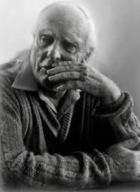
Meaning: Grice
In his famous paper, “Meaning,” Paul Grice distinguishes natural meaning from non-natural meaning.
Natural meaning:
"Those spots mean (meant) measles."
"Those spots didn't mean anything to me, but to the doctor they meant measles.”
"The recent budget means that we shall have a hard year."
Non-natural meaning:
"A meant_{NN} something by x" is (roughly) equivalent to "A intended the utterance of x to produce some effect in an audience by means of the recognition of this intention"; and we may add that to ask what A meant is to ask for a specification of the intended effect…

Slide 30
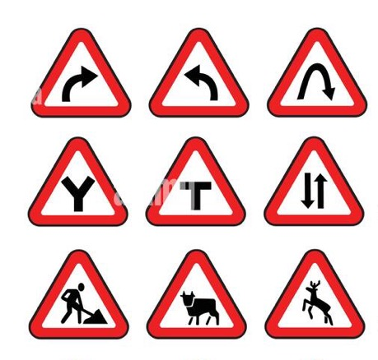
Natural Meaning: Stevenson/Skyrms
Stevenson’s view (according to Grice)
[F]or x to mean_{NN} something, x must have (roughly) a tendency to produce in an audience some attitude (cognitive or otherwise) and a tendency, in the case of a speaker, to be produced by that attitude, these tendencies being dependent on "an elaborate process of conditioning attending the use of the sign in communication.”
Brian Skyrms (2010) work on signals:
Darwin sees some kind of natural salience operating at the origin of language. At that point signals are not conventional, but rather the signal is somehow naturally suited to convey its content. Signaling is then gradually modified by evolution. Darwin is thinking of biological evolution, but for humans (and some other species) there is a version of the account that substitutes cultural evolution or social learning for biological evolution. (20)

Slide 31
Vervets
Cheney and Seyfarth [1990] show that vervets have distinct alarm calls for different classes of predator: a “cough” for an eagle, a “bark” for a leopard, and a “chutter” for a snake. For each predator a different evasive action is optimal. For leopards it is usually best to run up a tree and out on a branch where a leopard cannot follow; for snakes one should stand tall and scan the ground to locate the snake and then move away from it; for eagles it is best to exit a tree, take cover in the underbrush, and look upward to detect the location of the predator. Each alarm call elicits the appropriate behavior—both in the natural setting and in experiments where recorded alarm calls are played back. (Skyrms 2010, 22-3)
Moreover, vervets can learn the calls of birds (the Superb Starling) and respond appropriately to their warnings as “eavesdroppers” (Skyrms 2010, 24; also Deshpande 2022). And vervets are known to use the signals deceptively (Cheney and Seyfarth 1990).

Slide 32
Vervet meanings
Skyrms provides a simple model of a signaling system (Skyrms 2010, 23):
SENDER RECEIVER
eagle → cough cough → underbrush
leopard → bark bark → run up tree
snake → chutter chutter → scan and move
Plausibly the vervet cough has social meaning in the vervet group. Social meaning of this sort does not require (though it may, in some cases or in some species, involve) sophisticated mental states and metacognition and neither the carrier of social meaning (the signifier), nor the information transmitted, need be linguistic. Nevertheless, information is transmitted, specifically, information that is relevant to agency.

Slide 33
Communicating Information
Which way did your friend go?
Where does the structure of options come from?
This works due to several background conditions: you have a common interest (you both want to meet up), there are a limited number of live options (your friend will have stuck to a path and not wandered into the underbrush), and the stack of rocks was unexpected, surprising.

Slide 34
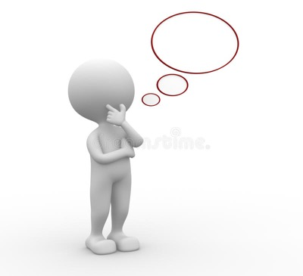
Teleological interpretation of options
If we have no prior practices to rely on to interpret others or to deliberate, we begin by considering: what options would make the most sense, given the goal?
For example, traditional Euro- American contexts, there might be a question about whether to eat a particular kind of food (fruit salad?) with a fork or spoon; chopsticks were not an option. Chopsticks were not available, the skill to use them was not widespread and passed down, and other available options (cutlery) were satisfactory. Shifts in the material conditions or cultural exchange can lead to broadening the options.
Social practices build on this through social learning: some options are ruled out, others made salient, and others still are made possible through material interventions (including technology), skill-building, as well as contestations, transpositions, and permutations of existing social meanings.

Slide 35
Content
One thing we get from a cultural technē is a set of signals that convey important information that is relevant to meeting our common interests.
Consider: pink means girl. The color pink is a signal. We have a common interest in speaking intelligible English. Until recently, the options were limited (‘she’-series or ‘he’-series), and pink ribbons, blankets, sweaters, etc. gave us the information we needed to choose.
Signifier
Signified
Note that neither the signifier nor the signified are beliefs or psychological attitudes.
If we are simply thinking about a framework or system of meanings, and if meaning is information conveyed by signifiers (the apparatus), then a framework can be described without reference to the psychology of those who take it up.

Slide 36
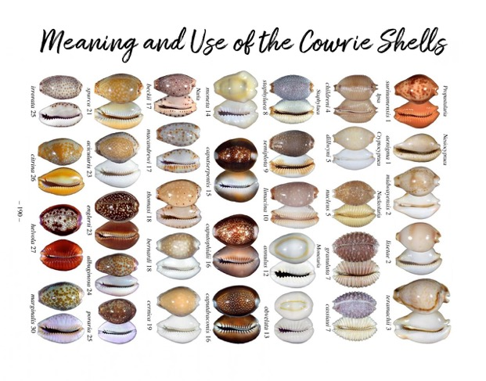
Materiality of signifiers and signified
In an actual practice, the signs are gestures, vocalizations, bits of paper, cloth, or metal. Because a cultural technē is a frame of meaningful signifiers, or signs, and because such signs – both the signifier and the signified – have a material existence, a cultural technē is not “in the head,” it is not psychological.
However, because the link between signifier and signified has to “convey information” in order to be effective, the uptake of a cultural technē by agents will require processing the relevant information; this is, in most cases, a psychological process.
If we are simply thinking about a framework or system of meanings, and if meaning is information conveyed by signifiers (the apparatus), then a framework can be described without reference to the psychology of those who take it up.

Slide 37
Outline
Recap and Introduction
Psychological and Materialist Approaches
Signaling and Content
Uptake in Practices
Conclusion

Slide 38
Questions
1) What exactly are the constituents of a cultural technē? Is it psychological? Material? Both? Neither? Is there a coherent ontology?
A framework of social meanings – consisting of signifier and signified (signs) – are not psychological. However, to be effective for coordination, they need to be “taken up” in a community.
2) There are many possible cultural technēs that could manage coordination of a group. What does it mean to say that a cultural technē is ours? What determines whether it is ours?
3) How does a cultural technē manage us? In particular, how does an ideological technē manage us, given that it is typically false or misleading and produces unjust or harmful social stratification?
4) What is it for a group to “take up” a cultural technē or for an individual to be “in the grip” of an ideology?

Slide 39
Questions
1) What exactly are the constituents of a cultural technē? Is it psychological? Material? Both? Neither? Is there a coherent ontology?
A framework of social meanings – consisting of signifier and signified – are not psychological. However, to be effective for coordination, they need to be “taken up” in a community.
2) There are many possible cultural technēs that could manage coordination of a group. What does it mean to say that a cultural technē is ours? What determines whether it is ours?
3) How does a cultural technē manage us? In particular, how does an ideological technē manage us, given that it is typically false or misleading and produces unjust or harmful social stratification?
4) What is it for a group to “take up” a cultural technē or for an individual to be “in the grip” of an ideology?

Slide 40
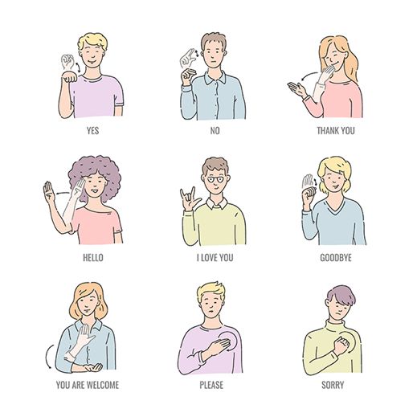
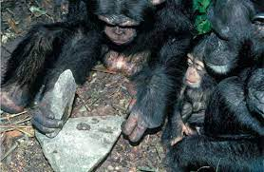
Uptake
Because a cultural technē is part of a practice (or system of practices), we have the resources to explain both how it is taken up and how it functions.
The taking up, however, is not just a matter of copying. It allows for elaboration, improvement, contestation, etc. It is a dynamic and evolving process.
It functions by
making collectively salient some options rather than others and
providing signals so we can better coordinate.
It is taken up through social learning while engaging collectively in activities that distribute resources.

Slide 41
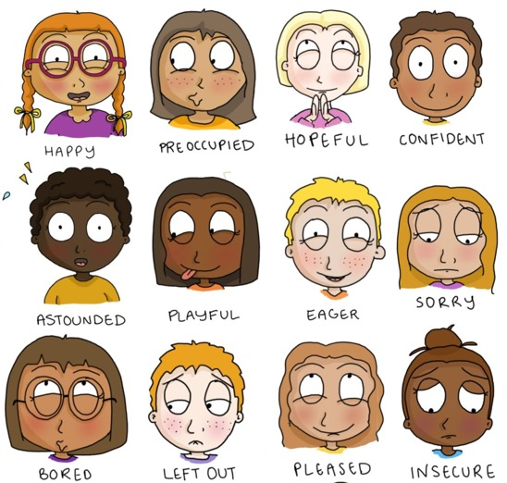
Is Uptake Always by Belief?
First, the information may not be, properly speaking, propositional.
Second, it might be belief in different senses: a low-level responsiveness (think of the “teleological stance”) to the information; or a sophisticated propositional attitude whose content is determined holistically with an individual mode of presentation.
Third, believing the information transmitted is not necessary for coordination. One may only need to accept it for the purposes of the immediate need to coordinate. So the particular social meanings at work in a particular context may be neither widespread or dominant.
Finally, affective states may also be taken up for the purposes of coordination.

Slide 42
Outline
Recap and Introduction
Psychological and Materialist Approaches
Signaling and Content
Uptake in Practices
Conclusion

Slide 43
Return to Ideology
(ii) it should not be fully transparent to us (in some cases we should be guided by cultural technē and not realize it).
Because it guides us in fluent action, it need not be explicit or conscious. In simple cases, it may be little more than an apt responsiveness that is not chosen or intended.
Let’s return now to how a cultural technē functions as an ideology. To do so, it should have several key features:
(i) it should be public (this is necessary for it to serve its coordinating function).
It is public because it is learned in the process of coordination from others who are participants.
(iii) it should sometimes distort or occlude parts of the world in ways that promote or sustain unjust social stratification.
And it is possible for it to hide or distort the options because material conditions can be confusing and efforts to build on natural salience is not reliable; and those who are engaged in the practice can distort salient options – even making them look good – that aren’t good for the agent.

Slide 44
Answers to Questions….
1) What exactly are the constituents of a cultural technē? Is it psychological? Material? Both? Neither? Is there a coherent ontology?
I’ve argued that a cultural technē is a system of signs. It includes an apparatus (signifiers) and the information they carry to pick out the signified. There are many possible frameworks that could enable us to coordinate, some better and some worse than others for achieving just coordination.
2) There are many possible cultural technēs that could manage coordination of a group. What does it mean to say that a cultural technē is ours? What determines whether it is ours?
A cultural technē is ours because it functions, through our practices, to manage our coordination, whether anyone actually believes its contents or not. To be effective, it must be “taken up” by individuals when engaging in social practices.

Slide 45
3) How does a cultural technē manage us, especialy given that it is typically false
or misleading and produces unjust or harmful social stratification?
It manages us because we are highly motivated to coordinate and it gives us the tools to do so. Even in cases where we don’t believe the information necessary for coordination, it is often in our interests to accept it for the purposes at hand. And because we act on resources in ways guided by the technē, the world comes to conform to what we are asked to believe. Then we aren’t believing falsehoods, but are actually believing truths! So it is hard to reveal the problem.
4) What is it for a group to “take up” a cultural technē or for an individual to be “in the grip” of an ideology?
A group takes up a cultural technē in the evolution and intergenerational transmission of its social practices. Such practices manage the framing of options, the production, distribution, recycling of resources, and contestation over their values, beliefs, and organizing principles.
A group is in the grip of an ideology when its cultural technē obscures valuable options and ways of valuing and if it organizes resources in unjust ways.

Slide 46
Thanks for your attention!!

