Slide 1
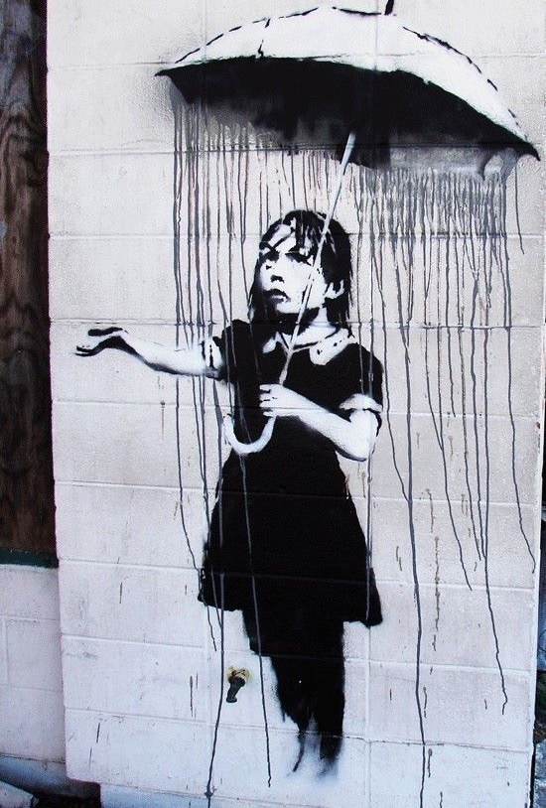
The Epistemology of Consciousness Raising
Sally Haslanger
San Raffaele
10 June 2022

Slide 2
Outline
Background and Introduction
Social Reproduction
Challenges for Ideology Critique
Situating Social Critique
Starting Points: Embedded Inquiry
Illumination, Justification, Politics
Oppositional Consciousness: Case Study
Oppositional Political Epistemology
Conclusion

Slide 3
Outline
Background and Introduction
Social Reproduction
Challenges for Ideology Critique
Situating Social Critique
Starting Points: Embedded Inquiry
Illumination, Justification, Politics
Oppositional Consciousness: Case Study
Oppositional Political Epistemology
Conclusion

Slide 4
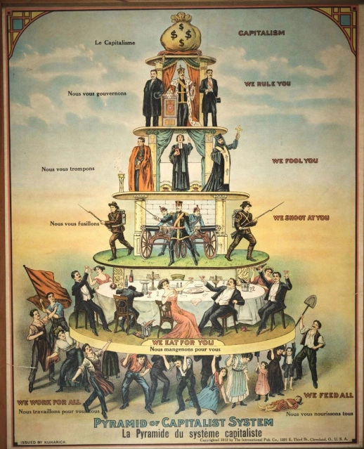
Social Reproduction
In order to address pressing issues of social justice we need to better understand the social domain.
I have defended a “practice first” account of the social domain according to which practices set the stage setting for coordinated action.
Societies are structured systems that sustain themselves over time.
How do they do so?
Practices depend on a set of shared meanings – a cultural technē – that provides the paths and signals for intelligible agency.
Designing just laws and fair economic institutions is not enough – we need to change practices. One strategy is to disrupt ideology.

Slide 5
Ideology Critique?
If our social practices and corresponding practical orientations are shaped by ideology, how is critique possible?
External critique – If we rely on beliefs and values that aren’t broadly accepted in the social context, our critique will be (at best) ineffective or (at worst) paternalistic.
Internal critique – If we rely on beliefs and values that are internal to the ideology, critique is unlikely to identify the wrongs adequately.
Response: We rely on an oppositional standpoint achieved through consciousness raising to offer an alternative paradigm that is empirically sound and less coercive as a basis for social coordination.
Response: The internal/external distinction is not as apt when thinking of an ideology as a set of tools – a technē – and as culture as fragmented and compartmentalized around practices. Nevertheless…
Normative challenge:
Are there objective moral truths by reference to which we can judge social arrangements to be unjust?
Methodological challenge: From what standpoint does the critic speak? Which insights of which agents are warranted?

Slide 6
Outline
Background and Introduction
Social Reproduction
Challenges for Ideology Critique
Situating Social Critique
Starting Points
Illumination, Justification, Politics
Oppositional Consciousness: Case Study
Oppositional Political Epistemology
Conclusion

Slide 7
Starting Points for Social Critique
Mid-stream inquiry: We are not starting the normative inquiry from scratch. Those engaged in justified political resistance cannot avoid the claim that there are some moral truths. So the task is NOT to argue for an objective basis for moral judgment.
Practice directed: The site of ideology critique is the social domain. The primary issues concern what practices we should engage in, what social norms we should embrace, how we should go on, from here, together.
Aimed at positional vulnerability: An individual can be treated unjustly qua individual. But within the social domain individuals are vulnerable to perpetrating or suffering injustice by virtue of their social positions. The aim of critique is to identify and eliminate this positional vulnerability.

Slide 8
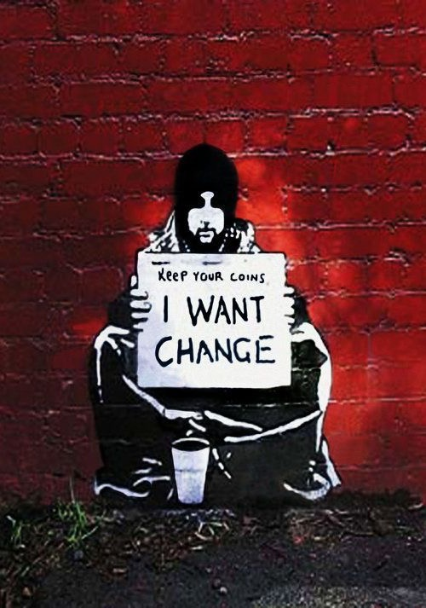
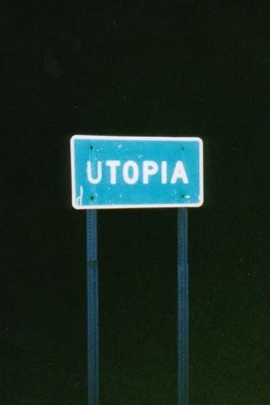
Starting Points, continued.
Anti-Utopian: There are many ways to organize social life, so l goal is not to ask what practices are the best way. (This is not ideal theory.)
Contextual solutions: A normative/critical social theory provides tools to identify ways in which our current practices are inadequate so we can do better.
What counts as better is a contextual matter; there are no one-size fits all solutions.
What’s better will depend hugely on local factors, such as the geography, economy, cultural traditions, and human biology.
Critical: Because in existing societies, injustice is already rampant, rectification is a priority. Resistance is the starting point.

Slide 9
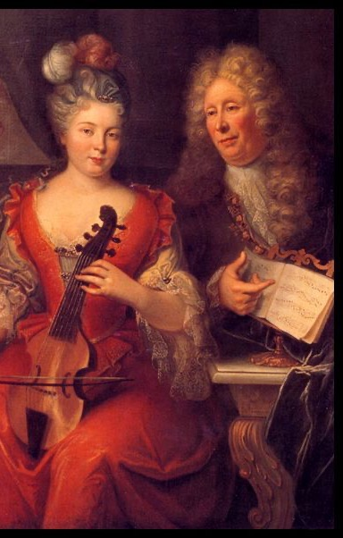
Path Dependency of Value
One may be concerned that once we recognize that there are many acceptable ways to organize social life and that our critique is always situated, we must give up on the objectivity of value.
However, objective values need not be ahistorical or acontextual; they may be path-dependent. What’s valuable depends, inter alia, on what is available to value.
Values are not so much what humans have as what they do and feel. Human beings possess an inexhaustible drive to evaluate, to pronounce what is good and bad, beautiful and ugly, advantageous and disadvantageous. Without culture, human values are inchoate and indeterminate; through culture they become differentiated, articulated, and refined. (Balkin 1998, 27-28)

Slide 10
Illumination, Justification, Politics
The justification problem: whether we have a justified complaint against the current social order, i.e., that some practice or set of practices is harmful or unjust.
As social critics, we should distinguish:
In critical theory these are often joined because critical theory should be emancipatory. But they need not be.
We should also distinguish these from:
The illumination problem: how do we get others to recognize their oppression and join our movement?
The task today is to address the justification problem. Under conditions of ideology, justification is pressing. I will not address the illumination problem and will only gesture towards a way of thinking about the political problem.
The political problem: what we, collectively, should do about the injustice we find (and how to decide). Rarely can all pro tanto political complaints be adequately addressed. Also, power matters.

Slide 11
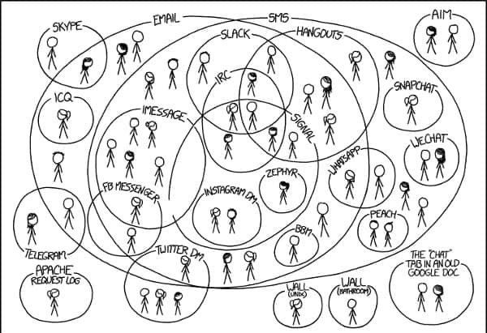
Rethinking Internal/External Divide
Societies are not unified and hegemonic; they are fragmented. Social roles and practices are not well-organized. Ideologies are contradictory.
Social critique can, at the very least, draw on our inchoate and indeterminate sense of justice and its articulation in different contexts to construct and demand a better alternative to the current practices.
The fragmentation of our social practices and relative autonomy of social systems generates tensions and contradictions. Comparisons across cultures and sub-cultures illuminate different forms of life. (“Double consciousness” (DuBois); “outsider within” (Collins)).
This can prompt reflection on our normative resources, and how we might better go on from here.

Slide 12
Outline
Background and Introduction
Social Reproduction
Challenges for Ideology Critique
Situating Social Critique
Starting Points: Embedded Inquiry
Illumination, Justification, Politics
Oppositional Consciousness: Case Study
Oppositional Political Epistemology
Conclusion

Slide 13
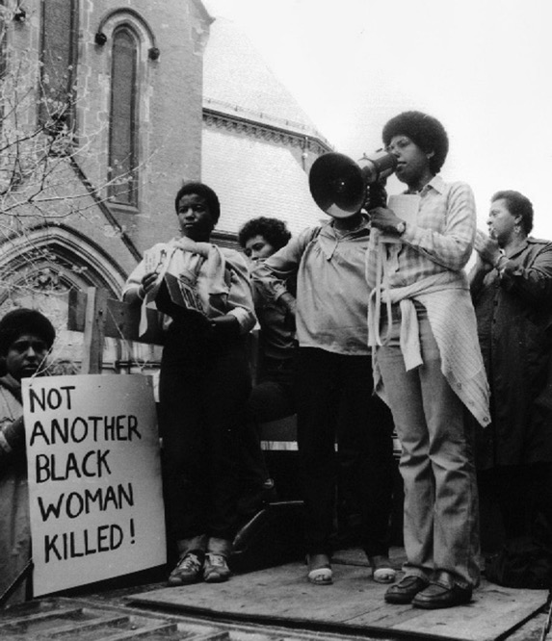
Combahee River Collective (“A Black Feminist Statement” 1977)
In 1974 a group of Black women started meeting in response to their experiences in everyday life, in the Civil Rights Movement (CRM) and the Women’s Liberation Movement (WLM).
Their frustration had roots in their situation: “the political realization that comes from the seemingly personal experiences of individual Black women’s lives,” and also the failures of both the CRM and WLM to give them the tools to develop an adequate response: “there was no way of conceptualizing what was so apparent to us, what we knew was really happening.” (33)
Through a process of consciousness raising, they explored the experiential, cultural, and political dimensions of their experience, and developed new terms and concepts.
Barbara Smith 1979
We discovered that all of us, because we were “smart,” had also been considered “ugly,” i.e., “smart-ugly.” “Smart-ugly” crystalized the way in which most of us had been forced to develop our intellects at great cost to our “social” lives.” (34)

Slide 14
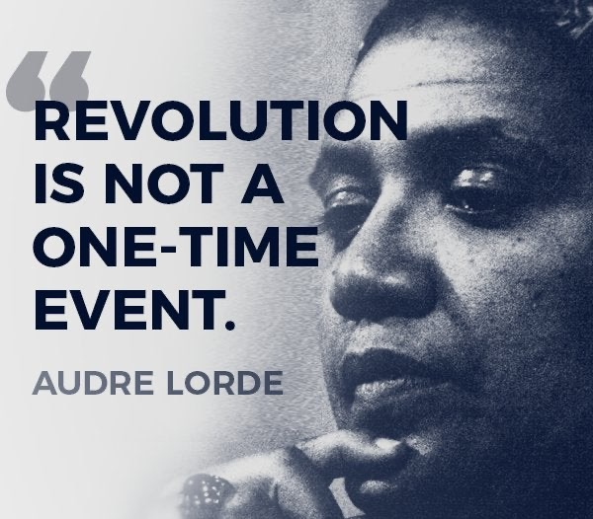
Consciousness Raising
Through CR, they reached
[the] shared belief that Black Women are inherently valuable, that our liberation is a necessity not as an adjunct to somebody else’s but because of our need as human persons for autonomy…” (33) and “to be recognized as human, levelly human, is enough.” (34)
The group that persisted through 1977 – when the statement was written – decided that CR was not enough. They developed a study group, and decided to promote their cause through writing, publishing, lecturing, and other activist organizing. They conclude,
We believe in collective process and a non-hierarchical distribution of power within our own group and in our vision of a revolutionary society. We are committed to a continual examination of our politics as they develop through criticism and self-criticism as an essential aspect of our practice. (37)

Slide 15
Outline
Background and Introduction
Social Reproduction
Challenges for Ideology Critique
Situating Social Critique
Starting Points: Embedded Inquiry
Illumination, Justification, Politics
Oppositional Consciousness: Case Study
Oppositional Political Epistemology
Conclusion

Slide 16
“Desiring Negation”
Jane Mansbridge uses the term ‘oppositional consciousness’ to capture a particular kind of response to oppression. She suggests that oppositional consciousness in liberation movements requires:
Iris Young calls this starting point a “desiring negation” (See 1990, 6-7)
…a gut refusal to be subordinated rooted somewhere in every human being…To form an effective basis for collective action, gut refusals need cognitive and emotional organizing. They need an injustice frame…They need an apparatus involving both reason and emotion... (2001, 4)
Desire…creates the distance, the negation, that opens the space for criticism of what is. This critical distance does not occur on the basis of some previously discovered rational ideas of the good and the just. On the contrary, the ideas of the good and the just arise from the desiring negation that action brings to what is given.
Each social reality presents its own unrealized possibilities, experienced as lacks and desires. Norms and ideals arise from the yearning that is an expression of freedom: it does not have to be this way, it could be otherwise.

Slide 17
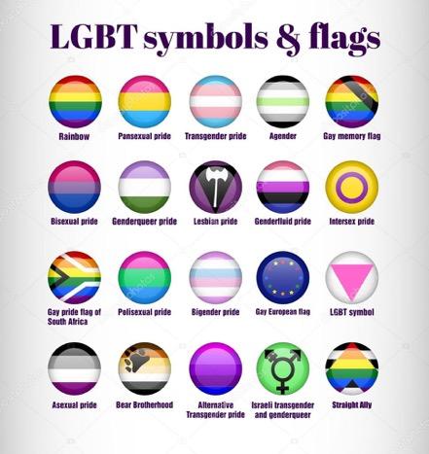
Social Movements
Drawing on empirical case studies, Mansbridge, et al (2001, 5) argue that certain tools are valuable in moving from a gut refusal to an “injustice frame.”
Oppositional consciousness transforms into a movement when those in the group “demand changes in the polity, economy or society to rectify those injustices.” (1)
…An existing oppositional culture provides (i) ideas, rituals, and long-standing patterns of interaction that overt political struggle can refine and develop to create a more mature oppositional consciousness…(ii) a history of segregation with some autonomy, providing “free spaces” for the elaboration and testing of ideas; (iii) borrowing from previous successful movements; the synthesis of more than one oppositional strand, creating more than the sum of its parts; (iv) mutually supportive interaction, bridging divides in emotional commitments; and (v) consensus creativity by activists, drawing on the traditions and practices of everyday life. (2001, 7-8, my numbering)

Slide 18
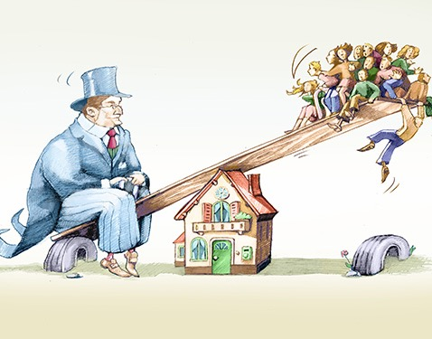
Epistemology of Social Critique
Under conditions of ideology, a primary task is to articulate a (warranted) moral claim in the name of the subordinate group.
The claim is made against those with whom one coordinates – in a classroom, a family, an institution, a nation – and makes a demand that the terms of coordination be changed.
I assume that one need not be a member of the subordinate group in order to demand justice with them (Pohlhaus 2002). But in a liberation movement, the process of articulating a claim typically begins with those directly affected.
It is plausible that oppositional consciousness arises and can be justified in a variety of ways. The process I am exploring begins with a reaction, moves to a complaint, and results in a pro tanto moral claim. (I draw on Anderson’s pragmatist moral epistemology (2018).)
The key epistemic project is to prompt a paradigm shift that enables us to see the status quo as the product of ideology: a culture that produces an unjust social reality while masking its production.

Slide 19
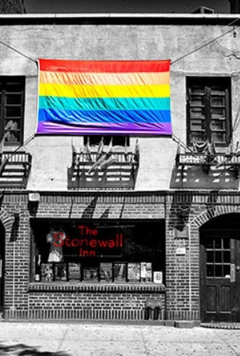
ONE Method of CR
One has a moral “gut refusal” to one’s circumstances. Whining is an indication of displeasure, but does not rise to the level of a legitimate complaint against others. How do we transform whining into complaining?
Test the reaction against the experience of others: Articulate the concern to others within the same (affected) social group; the process from here forward is collective.
Create counter-publics where the subordinated can complain to each other without being “corrected” by members of the dominant group.
Consider: Is the problem individual or social? Is it a positional vulnerability?
This process involves shifting orientations to notice facts that have been occluded – empirical facts, morally relevant facts, facts about possibilities.

Slide 20
Identities and Epistemic Injustice
Individuals within the group can sometimes rely on existing identities, but in other cases new “identities” are called for (Mansbridge, 9).
The new shared identities (Black feminist, queer) allow for a cultivation of trust, new language, shared interests, etc.
Patterns can then become more visible, new hermeneutic resources developed (“smart-ugly,” “misogyny”).
The “testing” process – at this stage and later stages – should involve forms of bias reduction and consideration of epistemic injustice of all sorts.

Slide 21
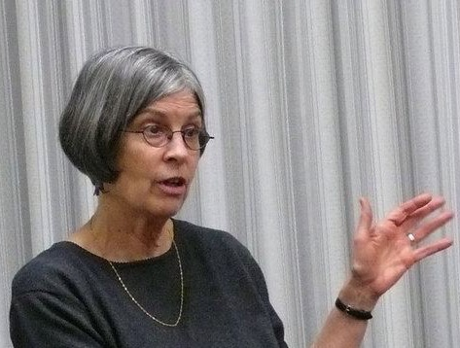
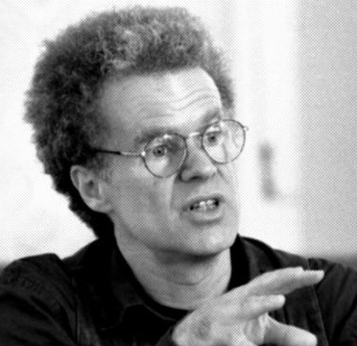
Critical Social Science
Develop a hypothesis about the source of the problem. Who/What is responsible for the problem? Is the coordination system faulty or are there other problems, e.g., bad actors? (See also Mansbridge 2001, 5)
Test the hypothesis. Is it empirically adequate? Is the hypothesis is the best explanation of the phenomenon? (Cf. Neo-Nazis, Anti-Vaxxers) Draw on resources in critical social science. (I endorse a feminist philosophy of science (Longino et al) that yields an externalist account of objective justification.)
Revise the hypothesis, as needed.
Articulate a claim challenging the practice, e.g., this (part of the) practice is unjust, oppressive, harmful, or wrongful.
Helen Longino
This is how I propose we address the justification problem. I am not proposing here a theory of politics.
Erik Olin Wright

Slide 22
Political Stage (no guarantees!)
Suggest proposals for corrective procedures and practices.
If deliberation concerning the claims and proposals is unsuccessful, resort to non-deliberative interventions, “from petitioning, publicity campaigns, theatrical performances, candlelight vigils, litigation, and political campaigns to street demonstrations, boycotts, teach-ins, sit-ins, picketing, strikes, and building occupations.” (Anderson 2014, 9)
Even if a proposal is met with agreement in the public sphere, this is not the end of the story. Anderson suggests we must ask:
Repeat as needed.
“ [i] Does acting on the new judgments solve the problem as originally diagnosed? …
[ii] Does it do so with acceptable side effects? An affirmative answer to both questions amounts to a successful test of the new judgment in an experiment in living.” (5-6)

Slide 23
Justification & Politics
On this view, an oppositional consciousness is warranted insofar as it moves from a “gut refusal” to a moral claim through a collective examination of shared experience, guided by sound epistemic norms.
What norms are “sound” is not simply a matter of what the dominant culture recommends, but also should be guided by best practices of social science, and the lived experience of those in the subordinate group. The resulting claim is made on behalf of a social group and warranted through their collective efforts.
An oppositional moral claim is not, simply by virtue of being the result of such a process, dispositive. Rather,it is a move in a process of contentious politics that deserves consideration in collective deliberation.

Slide 24
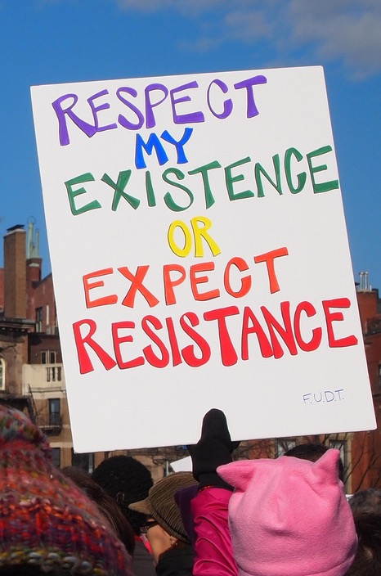
Contentious Politics
So how do we gain normative standing to critique culture?
Recall that under conditions of ideology there is, by hypothesis, a range of social practices that oppress a group; however, some do not experience them as oppressive.
Critique sometimes targets practices that constitute value for the practitioners.
I’ve argued, however, that an important form of social critique begins amongst those affected as a resistance to the practice that they are being asked to perform. Resistance arises from their knowledge that even if the practice constitutes some sort of value, it is harming them in ways that are morally problematic.
They reject the ideology that makes the injustice appear harmless and articulate a moral claim against those who maintain the practice.

Slide 25
Outline
Background and Introduction
Social Reproduction
Challenges for Ideology Critique
Situating Social Critique
Starting Points: Embedded Inquiry
Illumination, Justification, Politics
Oppositional Consciousness: Case Study
Oppositional Political Epistemology
Conclusion

Slide 26
Return to challenges
Normative challenge:
Are there objective moral truths by reference to which we can judge social arrangements to be unjust?
Methodological challenge: From what standpoint does the critic speak? Which insights of which agents are warranted?
Yes, but they may be path-dependent and a standpoint epistemology may be required to know them.
Insights from many perspectives are important. However, one form of warranted critique begins with a gut refusal but must withstand scrutiny through a sound epistemic process.

Slide 27
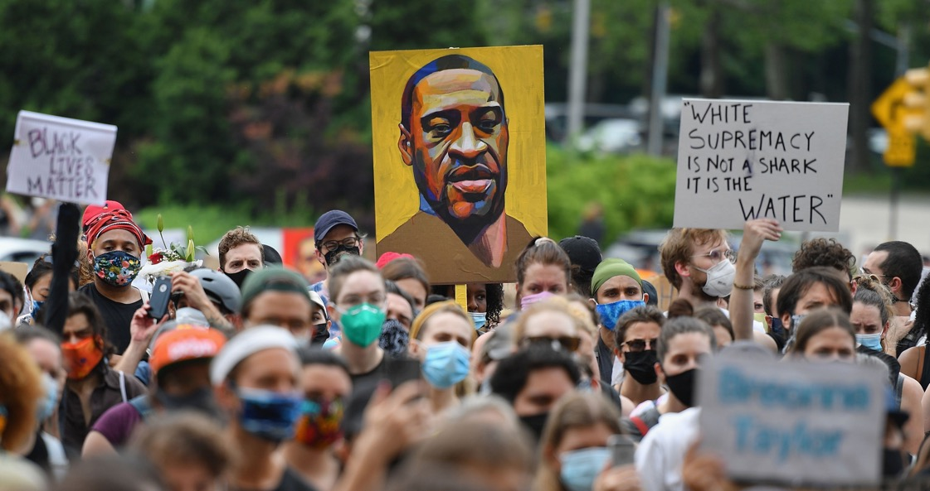
Conclusion
It may be that the values the resistant rely on when making claims of being harmed are at odds with what others engaged in the practice value. But that does not delegitimize their claims.
Social practices are cooperative enterprises, and if parties to the cooperation have reason to think that they are being treated unjustly, or their values being undermined, there is a pro tanto reason for all parties involved to reconsider the practice.
Insisting on terms of cooperation in the face of the non-consent of the opposition is coercive, and is a pro tanto wrong. This is the normative basis for contentious politics.

Slide 28
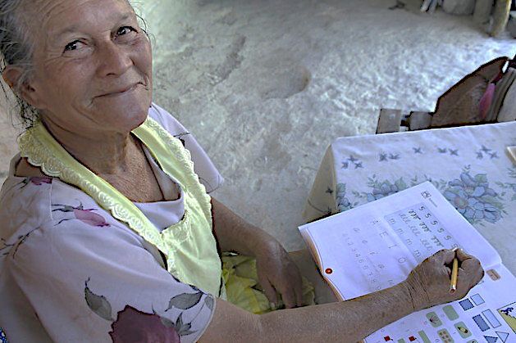
Thanks for your attention!

