Slide 1
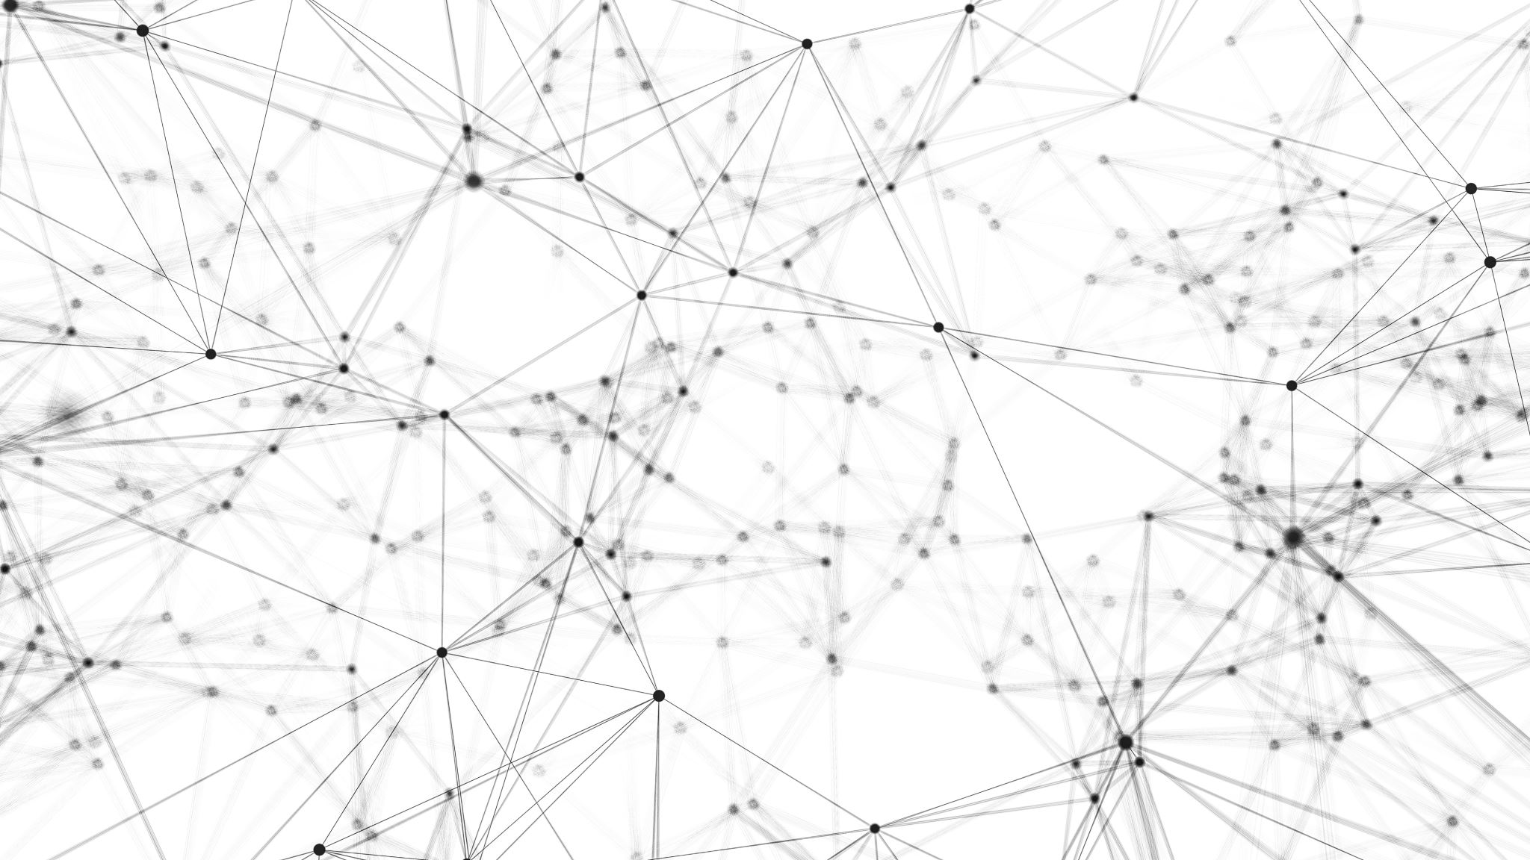
IDEOLOGY IN PRACTICE
Sally Haslanger
shaslang@mit.edu

Slide 2
Outline
Introduction
The Critique of Ideology (as a tool of analysis)
Economic Determinism
Ideology as Illusion
Cultural Determinism/Constraint
Social Practices
Culture
Looping
Conclusion: Ideology (a better view)

Slide 3
Outline
Introduction
The Critique of Ideology (as a tool of analysis)
Economic Determinism
Ideology as Illusion
Cultural Determinism/Constraint
Social Practices
Culture
Looping
Conclusion: Ideology (a better view)

Slide 4
Today’s Goals
I begin with a particular challenge for those working on social justice:
Why is it that most of us, most of the time, act in ways that perpetuate injustice and/or oppression?
Answer (?): We are implicitly or explicitly committed to an ideology that masks or distorts our understanding of social reality.
But what is an ideology? I’ll sketch some basics.
I will then consider some objections to the idea that ideology is the best tool for addressing our leading question.
I will then offer a different account of ideology – inspired by Althusser, among others – that embeds ideology in social practices. I will argue that it avoids the objections we considered.

Slide 5
What is an ideology?
The term ‘ideology’ is very broadly used to describe “the framework of meanings and values within which people exist and conduct their social lives” (Purvis & Hunt 1993, 479).
Within the tradition of critical theory, the term is used more specifically to describe frameworks that perpetuate systemic injustice/oppression, i.e., it is used in the pejorative sense. There are many forms of oppression, and ideological oppression is one distinctive kind: it occurs when subjects are recruited into – become agents of – oppressive systems.
[Ideology] has especially to do with the concepts and the languages of practical thought which stabilize a particular form of power and domination; or which reconcile and accommodate the mass of the people to their subordinate place in the social formation. (Hall 1996/2006, 24-25)

Slide 6
How does Ideology Function?
Ideology guides action; it is a ”practical consciousness.”
It can be implicit or explicit (so it may not be “conscious” in the ordinary sense).
It is a “perspective” that helps us communicate and coordinate.
It does so by shaping what we notice, remember, value, etc.
It functions to recruit agents into systems of oppression.
How does it do this?
Economic Determinism?
Ideology as Illusion?
Cultural Determinism?
Constrained Choice

Slide 7
Outline
Introduction
The Critique of Ideology (as a tool of analysis)
Economic Determinism
Ideology as Illusion
Cultural Determinism/Constraint
Social Practices
Culture
Looping
Conclusion: Ideology (a better view)

Slide 8
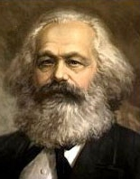
Economic Determinism?
Marxian answer: We are (somehow) caused by the economic structure of our social milieu to have attitudes that result in unjust and self-defeating behavior. Passages in Marx such as this are suggestive:
The totality of [the] relations of production constitutes the economic structure of society, the real foundation, on which arises a legal and political superstructure and to which correspond definite forms of social consciousness. The mode of production of material life conditions the general process of social, political and intellectual life. It is not the consciousness of men that determines their existence, but their social existence that determines their consciousness. (Marx 1859/1977, Preface)
Problem of determinism: Such structural (or economic) determinism is implausible.
We may be embedded in social structures, but we are not robots that lack autonomy.
It would be self-defeating for those seeking justice to accept a theory of ideology that precludes emancipation through social critique. If our attitudes are determined to support the status quo, then the only hope for social change lies outside of our agency.

Slide 9
I understand a materialist account as one that considers phenomena of "consciousness" - e.g., intellectual production, broad social attitudes and beliefs, cultural myths, symbols, images, etc. - as rooted in real social relationships.
This should not imply "reducing" such phenomena of consciousness to social structures and social relationships, nor does it even mean that the phenomena of consciousness cannot be treated as having a logic of their own.
Nor should it mean that phenomena like attitudes and cultural definitions cannot enter as elements into the explanation of a particular structure of social relationships, though I would claim that they can never be the sole explanation.
This requirement mainly calls for a methodological priority to concrete social institutions and practices along with the material conditions in which they take place.
(Iris Young 1980/1990, 33 – my italics)

Slide 10
Ideology as Illusion?
According to the simple account, we are led – through propaganda, “fake news” etc. – to believe falsehoods, and this is responsible for our complicity in injustice.
Propaganda (and other ways that falsehood is perpetuated in social systems) is a problem, but this approach faces serious challenges as a general account of how ideology works.

Slide 11
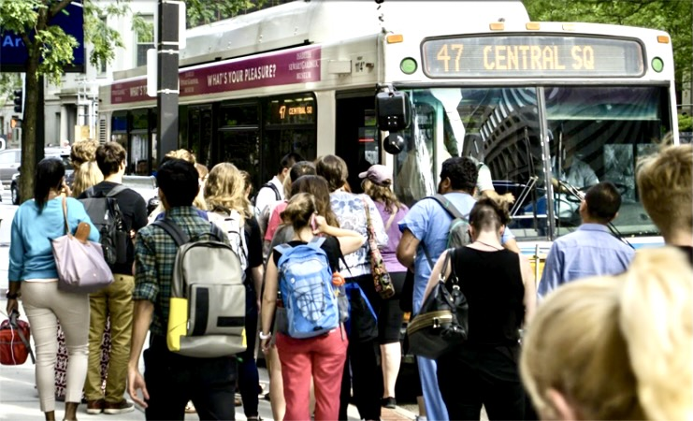
Is Ideology Always False?
Problem of Accuracy: Because ideology functions to create social reality, it sometimes “makes itself true.” MacKinnon: “...the more inequality is pervasive, the more it is simply “there.” And the more real it looks, the more it looks like the truth.” (MacKinnon 1989, 101) This also helps explain why we persist in forming ideological outlooks. (Though it’s complicated: ideology is often articulated using generics.)
For example, the poor, as a group, are less able to hold time-intensive jobs that impinge upon other responsibilities; after all, they can’t afford childcare, they depend on public transportation, and often hold more than one job.

Slide 12
How does ideology critique promote justice?
If ideology is the source of the problem, and ideology is a set of false beliefs that have become dominant, then are we assuming that “the truth shall set us free”?
Problem of Epistemic Respect: If ideology is a matter of false or distorted beliefs, then we live our lives under a pervasive illusion. We are self-destructively deluded about the choices we make and the reasons for them. This is implausible, and it doesn’t show respect for our basic epistemic capacities.
Problem of Emancipation: If the power of ideology lies in its falsehood, then what’s needed to make the world more just is access to the truth. “The truth shall set us free.” But given the problem of accuracy, this is dubious. Ideology has created an unjust world, and knowledge just mirrors it back.
This raises a broader epistemic problem: if what we believe can bring about injustice, then shouldn’t we be worried not just about truth/justification, but also about the moral aptness of our beliefs?

Slide 13
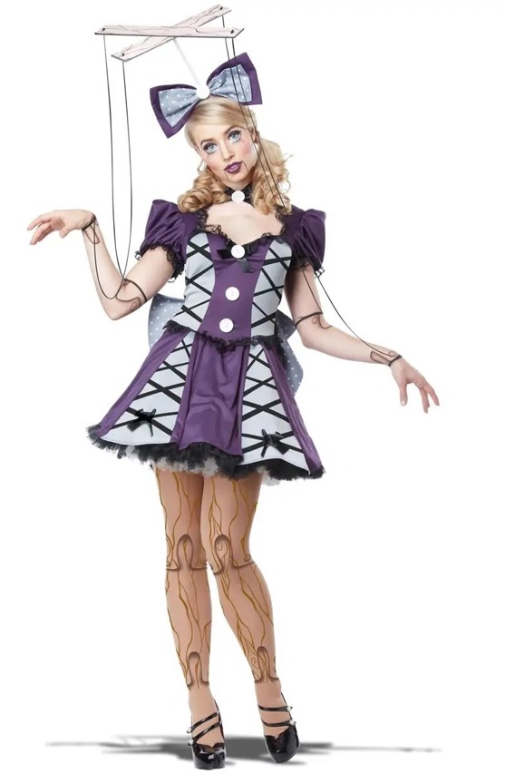
Anti-Representationalism (Cultural Determinism)
One diagnosis of the problems raised by ideology as illusion targets the idea of representation. Ideology doesn’t misrepresent the world because it doesn’t represent the world at all. On extreme versions of this approach, there is no such thing as “truth” or “knowledge.”
Even if we reject representationalism, our original problem remains. How do we explain our ongoing and yet unintended participation in structures of domination and subordination? One answer is that we we are simply socialized to do so.
Socialization is a crucial part of the story, but we should not replace economic determinism with cultural determinism. We are not – as noted before – cultural dupes.

Slide 14
Constrained Choice (Butler)
How does culture provide a framework for agency? On Butler’s view, we enact our social roles and identities by constrained choice:
…gender is a project, a skill, a pursuit, an enterprise, even an industry, the aim of which is to compel the body to signify one historical idea rather than another…. Hence, one does one's womanhood, one executes it, institutes, produces and reproduces it, wears it, flaunts it, hides it, but always stylizes it in one way or another. For gender is a corporeal style, a way of acting the body, a way of wearing one's own flesh as a cultural sign. (1989, 256)
One does not become a gender through a free and unconstrained act of choice, for gender identity is governed by a set of stringent taboos, conventions, and laws. There are punishments for not doing gender right. (1989, 256)
But this constraint is not without some moments of contingency, of possibility, of unprecedented cultural confusion that will invariably work to destroy the illusion that gender constraint is a dictate from nature. (1989, 261)

Slide 15
Constrained Choice (Hacking)
Ian Hacking has a similar view.
Intentional action involves an ability to represent what one is doing and to situate it within a frame of intelligibility or space of reasons.
The intentional dimension of the act depends on the available conceptual resources.
I bring you this wine so elegantly because I am an excellent garçon de café.

Slide 16
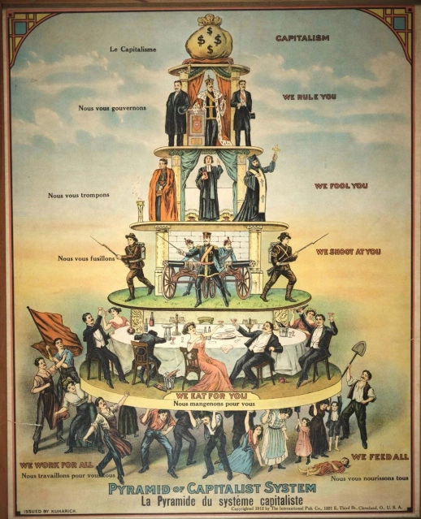
Materiality of Oppression
Butler (and Hacking) offer a way to locate a kind of agency constrained by what we have been calling asocial framework of meanings and values.
On their views the problem is: we lack certain conceptual tools to make a broad range of choices.
But how do we link such ideological constraints with structures of power and domination? Subordination occurs in the economy of social relations. And these social relations are a site of material injustice.
Problem of materiality: Ideology doesn’t just constrain our choices so that we are denied playful exploration of possibilities in constructing our own identities. It positions in dominant and subordinate relations. But how?

Slide 17
Outline
Introduction
The Critique of Ideology (as a tool of analysis)
Economic Determinism
Ideology as Illusion
Cultural Determinism/Constraint
Social Practices
Culture
Looping
Conclusion: Ideology (a better view)

Slide 18
Social Practices
Coordination around resources, i.e., things of (+/-) value, is a fundamental human task, and our ability to develop flexible forms of coordination that can be passed down through social learning is the key to our evolutionary success (Sterelny 2012).
Social practices are
patterns of learned behavior that, at least in the primary instances,
enable us to coordinate as members of a group in creating, distributing, managing, maintaining, and eliminating a resource (or multiple resources),
due to mutual responsiveness to each other’s behavior and the resource(s) in question,
as interpreted through shared meanings/cultural schemas (a cultural technē).

Slide 19
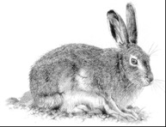
Psychological schemas:
filtering and shaping mechanisms
Cultural Technē/Ideology
Attitudes
A cultural technē (or a particular social meaning) is ideological insofar as it undergirds coordination that is sexist, racist, ableist, classist, etc. Not all cultural technēs are ideological.
Social Meanings
(Public)
Pet?
Food?
Pelt?
PRACTICE
Resources
(things +/- valued)

Slide 20
Cultural technē: What’s Included?
Simple meanings (pink means girl, red means stop) and other forms of signaling (greeting rituals, clothing choices, logos);
Narrative tropes (“First comes love, then comes marriage, then comes baby in the baby carriage”) and material signals and prompts for one’s place in them (wedding rings, “gender reveal” events and associated paraphernalia);
Default assumptions (“Marriage is between one man and one woman” “The US Constitution protects liberty and justice for all.”); Concepts (bachelor, marriage, sex, gender, race, water, justice) and alleged analytic truths about them);
Elements of architectural design (brick and ivy, toilets designated for men and women only, spaces only accessible by stairs, facade columns);
Heuristics (imitate-the-majority, or imitate-the-successful;
Familiar patterns of metaphor and metonymy (“God is love,” “The pen is mightier than the sword”);
Entrenched conceptual homologies (reason : passion :: man : woman);
Explicit public declarations (“Black Lives Matter,” “Blue Lives Matter”).

Slide 21
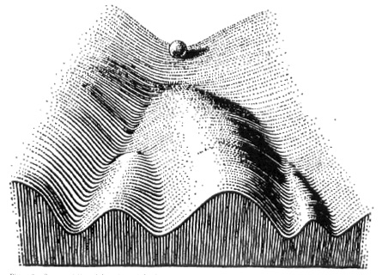
Constrained Choice Revisited
A cultural technē is a set of tools: Ann Swidler (1986) suggests that ‘[c]ulture influences action...by shaping a repertoire or ‘tool kit’ of habits, skills, and styles…’ (p. 273). The fragmentation of agency in different practices provides resources and opportunities for critique.
Vectors: Social vectors provide ‘forms of causality that are conduit-like rather than strictly cause-effect, directional rather than distinctly determinative, and relational rather than cleanly linear.’ (Richardson 2014, 221)
Social practices and structures provide, in effect, a topography upon which specific causal factors interact to produce probabilistic effects; cultural scripts and narratives create valleys in the topography along which agency easily flows. Although it may be easier to flow in the valley, we have choices to climb the peaks instead.

Slide 22
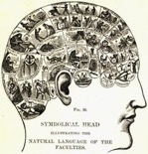
Looping
Culture provides tools for interpreting and responding to material conditions;
Agents internalize the tools as practical orientations in to coordinate and communicate;
Practical orientations guide us to act on material conditions and produce/distribute resources in accordance with the schemas,
This shapes the world to adapt to our tools and so facilitate coordination.
This looping has significant epistemic effects: the meanings we employ to interpret the world are confirmed by the world they have shaped. (This is the accuracy problem redux.) Thus it becomes difficult to even see that meanings/practices are problematic, for they appear to be warranted.

Slide 23
Outline
Introduction
The Critique of Ideology (as a tool of analysis)
Economic Determinism
Ideology as Illusion
Cultural Determinism/Constraint
Social Practices
Culture
Looping
Conclusion: Ideology (a better view)

Slide 24
Ideology: A Better View
An ideology is a set of tools – a cultural technē – that we use to coordinate in practices. a cultural tool is ideological relative to a practice that relies on it, when, and insofar as the practice is unjust/harmful.
A cultural technē can misshape a practice (a) because it prevents us from valuing things correctly (it distorts or occludes what is valuable); (b) because it guides the practice unjustly/harmfully.
A social practice can be bad/unjust itself. However, often practices (and their social meanings/schemas) can only be evaluated relative to their part in a particular socio-historical system. (I talked about this in the previous lecture.)
Unjust practices and institutions guided or formed by an ideology are ideological formations, e.g., racism, sexism, etc. The web of unjust social practices is held together by a racist technē, e.g., residential segregation, police brutality, biased hiring and wage inequity, educational disadvantage.

Slide 25
Return to challenges
Problem of Economic/Structural/Cultural Determinism
Culture sets conditions for constrained choice (this is compatible with autonomy).
There is an interdependence between culture and material conditions (looping), so the economy and material injustice is not neglected.
Problem of Accuracy
Ideology is not (just) a set of beliefs, but a framework of meanings and values. Culture’s representations must be evaluated by epistemic norms and also by reference to what they do.

Slide 26
More challenges?
Problem of Materiality
Relations of power emerge as we engage in social practices that distribute things taken to have value.
So this account gives apt attention to the “concrete social institutions and practices along with the material conditions in which they take place.”
Problem of Emancipation/Disrespect
Social critics are embedded in the societies they seek to change. Change involves coalition, contestation, dialogue. This is not disrespectful.
The truth will not set us free because the world we have created through our practices is the problem. Adequately describing how things are is important; but to achieve justice we must use imagination to think beyond how things are and establish new practices to get us there.

Slide 27
Thanks for your attention!

