Slide 1
Systemic and Structural Injustice
Sally Haslanger
shaslang@mit.edu

Slide 2
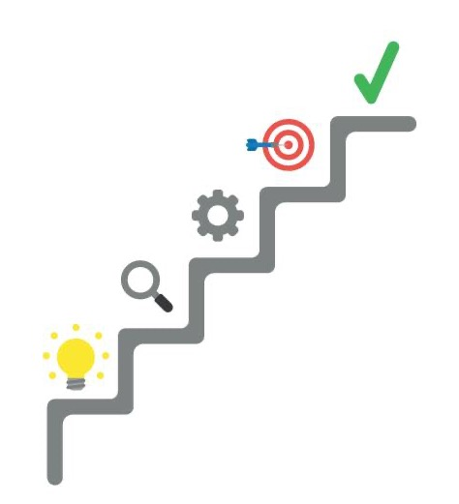
Outline
Introduction
Social Reproduction
Structures are the Skeletons of Systems
Social Relations Established in Social Practices
Social Stability
Power and the Body
Social Change
Legal/Institutional Change
Changing Culture: Not by Law Alone
Conclusion

Slide 3
Outline
Introduction
Social Reproduction
Structures are the Skeletons of Systems
Social Relations Established in Social Practices
Social Stability
Power and the Body
Social Change
Legal/Institutional Change
Changing Culture: Not by Law Alone
Conclusion

Slide 4
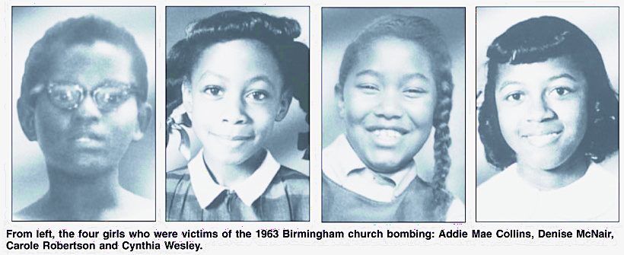
Systemic/Structural/Institutional Racism
In 1963, after the bombing at the 16th St. Baptist Church that killed four girls (Addie May Collins, Cynthia Wesley, Denise McNair, and Carole Robertson), Martin Luther King, Jr. gave a eulogy for three of them. One passage reads:
They are the martyred heroines of a holy crusade for freedom and human dignity. And so this afternoon in a real sense they have something to say to each of us in their death….They say to us that we must be concerned not merely about who murdered them, but about the system, the way of life, the philosophy which produced the murderers. (King/Washington 1991, 221)
http://digitalcollections.library.cmu.edu/awweb/awarchive?type=file&item=434085

Slide 5
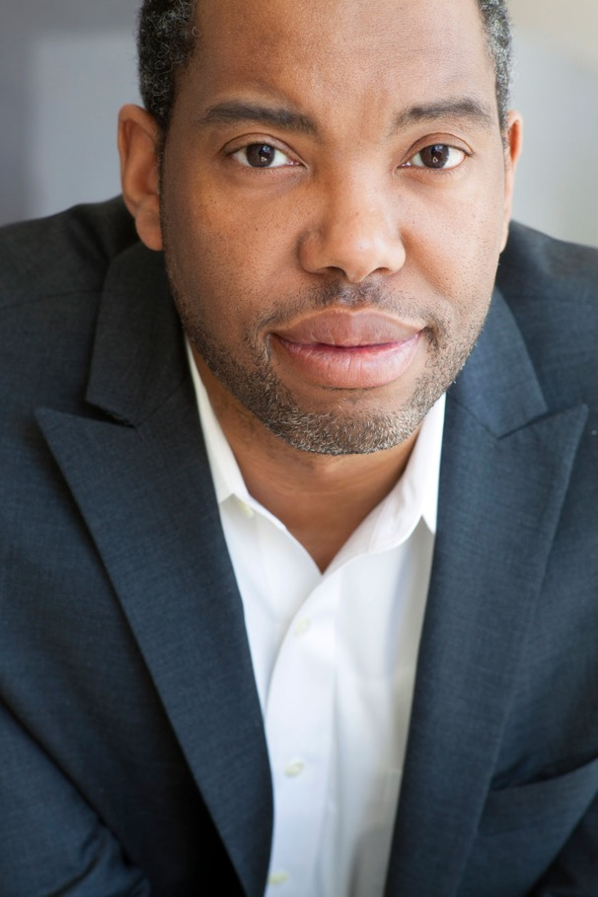
From Ta-Nehisi Coates, Between the World and Me
"But all our phrasing—race relations, racial chasm, racial justice, racial profiling, white privilege, even white supremacy—serves to obscure that racism is a visceral experience, that it dislodges brains, blocks airways, rips muscle, extracts organs, cracks bones, breaks teeth. You must never look away from this. You must always remember that the sociology, the history, the economics, the graphs, the charts, the regressions all land, with great violence, upon the body.” (Coates 2015, 10)

Slide 6
Questions
How should we understand systemic and structural racism? What does it mean to say that injustice is systemic or structural? Are these different terms for the same thing?
How do systemic and structural racism “land upon the body”?
Why is such injustice/oppression – more generally – so difficult to displace? How might we address it? Can philosophy help?

Slide 7
Outline
Introduction
Social Reproduction
Structures are the Skeletons of Systems
Social Relations Established in Social Practices
Social Stability
Power and the Body
Social Change
Legal/Institutional Change
Changing Culture: Not by Law Alone
Conclusion

Slide 8
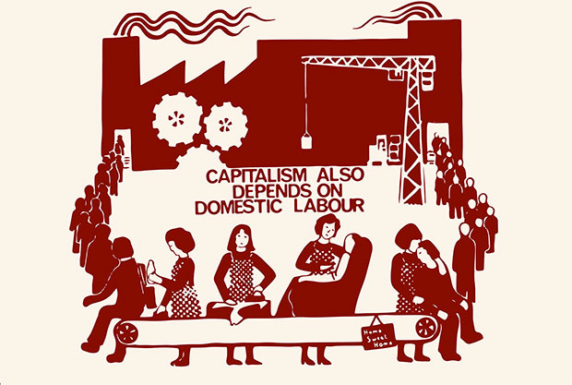
Social Reproduction

Slide 9
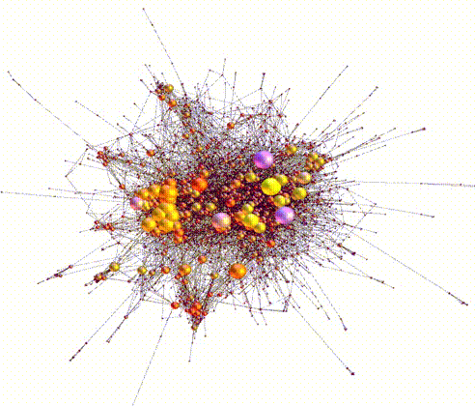
Structures are Skeletons of Systems
“SIMPLE”
Systems
Complex systems:
are not straightforwardly decomposable into independent parts,
the operations on the parts are not necessarily linear, and
they are self-organizing and stable due to feedback loops.
COMPLEX
Systems
organized complexity
CHAOS
disorganized complexity
The behavior of individuals in the system is unpredictable, but their interactions give rise to stable (emergent) features of the whole by virtue of an internal structure.
Examples: ecosystems, economies, climate, brains, ant hills, societies…
The structure of a system affects the individuals in it and the interactions that are possible.
In such systems, local interactions can spontaneously self-organize without external intervention or central authorities.

Slide 10
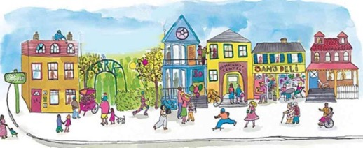
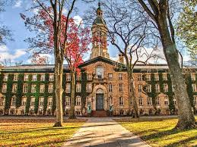
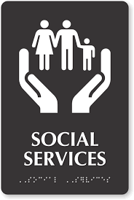
Overlapping systems
Educational System
Neighborhood/Real Estate System
Legal and
Social Services
System

Slide 11
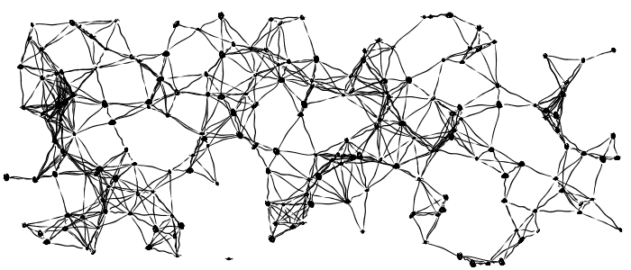
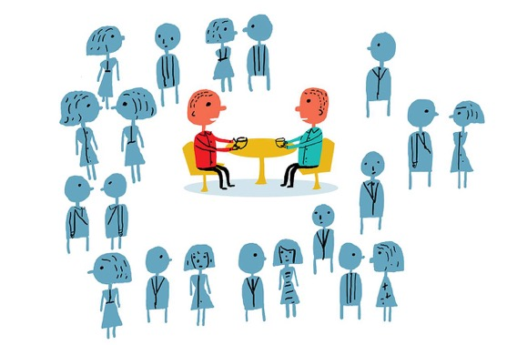
Structures are Networks of Relations
Structures form the skeleton of the system: they consist of places and relations (nodes and edges).
Social relations are established in practices, e.g., x is a mother of y is a biological relation, but is also a legal and social relation formed in practice.

Slide 12
What is a Social Practice?
Coordination around resources, i.e., things of (+/-) value, is a fundamental human task, and our ability to develop flexible forms of coordination that can be passed down through social learning is the key to our evolutionary success (Sterelny 2012).
Coordination relies on meanings, symbols, default assumptions and associations – that is, culture, or what I call a cultural technē – to shape our behavior.
We not only learn what is edible, but develop cuisines, menus, daily and holiday rituals...
On my account, an ideology is a cultural technē “gone wrong: it obscures or distorts what is valuable and/or organizes us in unjust/harmful ways.

Slide 13
Cultural constraints on agency
Any human behavior is conditioned by multiple factors.
It is constrained by:
The physical demands of the human body;
The geographical context and the edible things in it;
The social/political/legal context that makes certain edibles salient, available, safe;
The economic constraints on what we can afford; and
The social meaning of the different foodstuffs, i.e., culture.
Consider a meal…

Slide 14
January 2019, “Feast Fit For A Burger King: Trump Serves Fast Food To College Football Champs” (NPR)

Slide 15
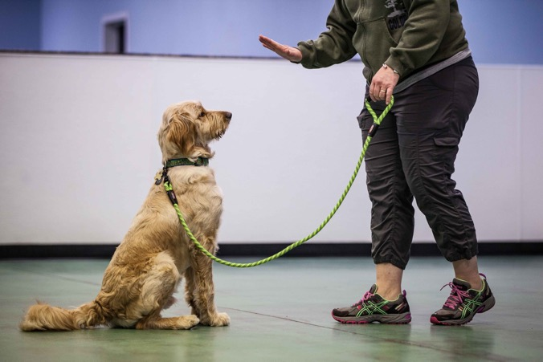
Semiotic Communities Share a Cultural Technē
Public meanings are internalized as we learn the “languages” of our local cultures; this is the basis for our fluency in social skills and capacities for code-switching.
I share some cultural tools with philosophical colleagues across the globe, others with my neighbors, and still others with my dogs.
Tools that are designed for one purpose are used for other purposes, including critique. (bricolage)
“…users of culture will form a semiotic community – in the sense that they will recognize the same set of oppositions [/meanings] and therefore be capable of engaging in mutually meaningful symbolic action. To use the ubiquitous linguistic analogy, they will be capable of using the "grammar" of the semiotic system to make understandable "utterances.”” (Sewell 2005, 49)

Slide 16
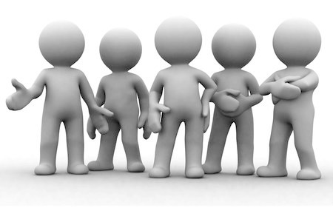
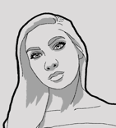
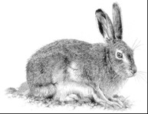
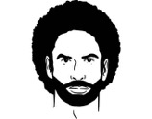
Social practices are
patterns of learned behavior that, at least in the primary instances,
enable us to coordinate as members of a group in creating, distributing, managing, maintaining, and eliminating a resource (or multiple resources),
due to mutual responsiveness to each other’s behavior and the resource(s) in question,
as interpreted through shared meanings/cultural schemas (a cultural technē).
Internalization of schemas produce: filtering and shaping mechanisms
Cultural Technē/Ideology
Cultural Technē/Ideology
Cultural Technē/Ideology
Attitudes
Social Meanings
(Public)
Social Meanings
(Public)
Social Meanings
(Public)
Pet?
Food?
Pelt?
Friend?
Janitor?
Criminal?
Friend?
Mother?
Sex Object?
PRACTICE
PRACTICE
PRACTICE
Resources
(things +/- valued)
Resources
(things +/- valued)
Resources
(things +/- valued)

Slide 17
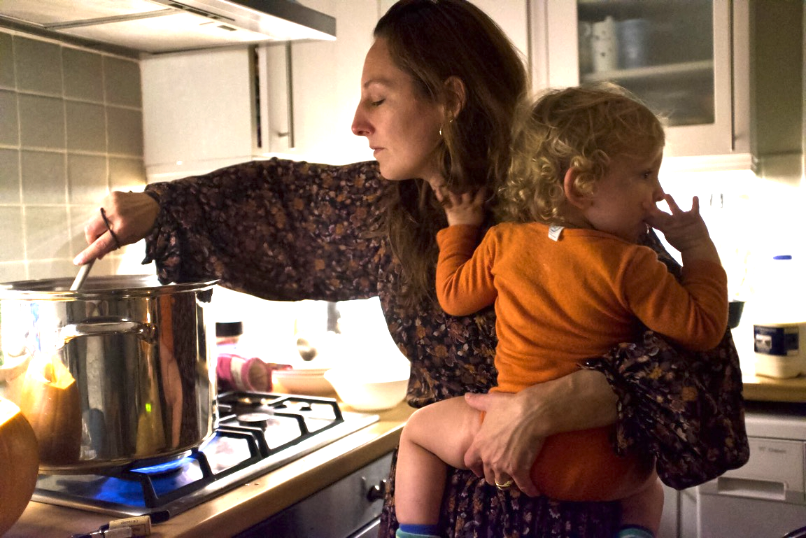
Structural Stability

Slide 18
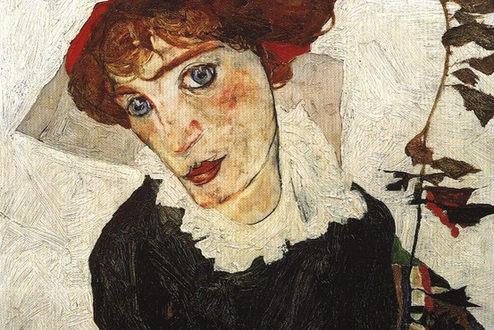
Subjectivization (Interpellation)
Egon Schiele 'Portrait of Wally' (1912).

Slide 19
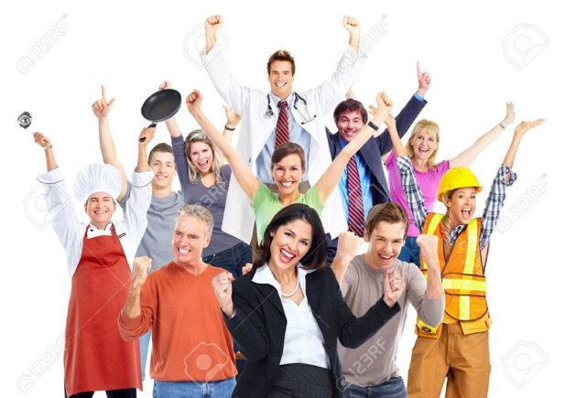
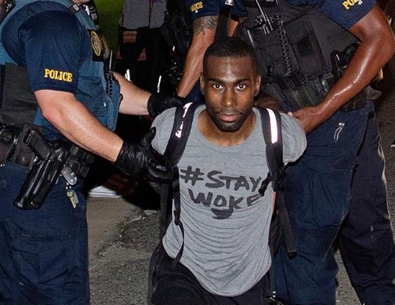
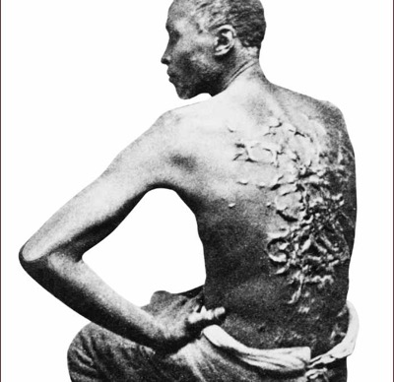
Power Lands on the Body
A structure of stable social relations produces individuals who are highly motivated to conform “all by themselves”. Those who are socially fluent don’t think twice about what to do: performing the role comes “naturally” – but it is second nature.
Hybrid: Ideological domination
& repression
Repression
Ideological oppression/exploitation

Slide 20
Outline
Introduction
Social Reproduction
Structures are the Skeletons of Systems
Social Relations Established in Social Practices
Social Stability
Power and the Body
Social Change
Legal/Institutional Change
Changing Culture: Not by Law Alone
Conclusion

Slide 21
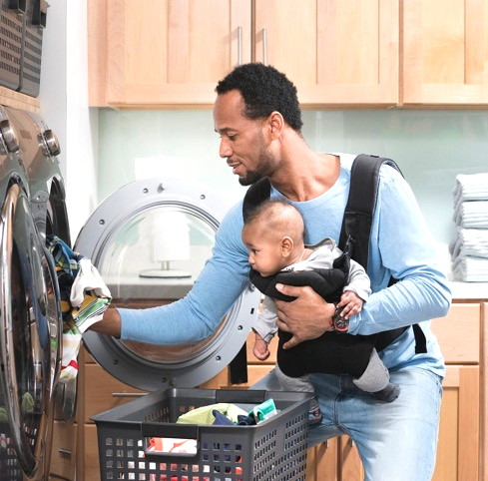
Leverage Points
The material and semiotic conditions of coordination make available certain choice architectures. Agency outside of the choice architecture can be physically impossible, legally forbidden, or socially unintelligible.
Psychological schemas:
filtering and shaping mechanisms
Cultural Technē/Ideology
Attitudes
Private action has limited impact in changing entrenched social practices.
Social Meanings
(Public)
Pet?
Food?
Pelt?
PRACTICE
Resources
(things +/- valued)

Slide 22
Social Change and the Law

Slide 23
How is law taken up in culture?

Slide 24
Dueling Example
Lessig, Lawrence. (1995). “The Regulation of Social Meaning.” University of Chicago Law Review 62(3): 943-1045.
Appiah, K. Anthony. 2010. The Honor Code: How Moral Revolutions Happen. New York: W. W. Norton & Co.

Slide 25
Social Movements Change Practices

Slide 26
Outline
Introduction
Social Reproduction
Structures are the Skeletons of Systems
Social Relations Established in Social Practices
Social Stability
Power and the Body
Social Change
Legal/Institutional Change
Changing Culture: Not by Law Alone
Conclusion

Slide 27
Tying some of the threads together
A cultural technē is the cultural dimension of the local social-regulation system.
When internalized by individuals, it provides tools for psycho-somatic self-regulation that enables fluent coordination with others; it also structures our subjectivity. We don’t need to be coerced to fulfill our social roles. We do it “all by ourselves.” (Althusser)
Because of its coordinating function, the structure has normative force.
Yet insofar as it regulates our interactions in ways that are problematic (morally, epistemically, politically), we ought to change it. But HOW?

Slide 28
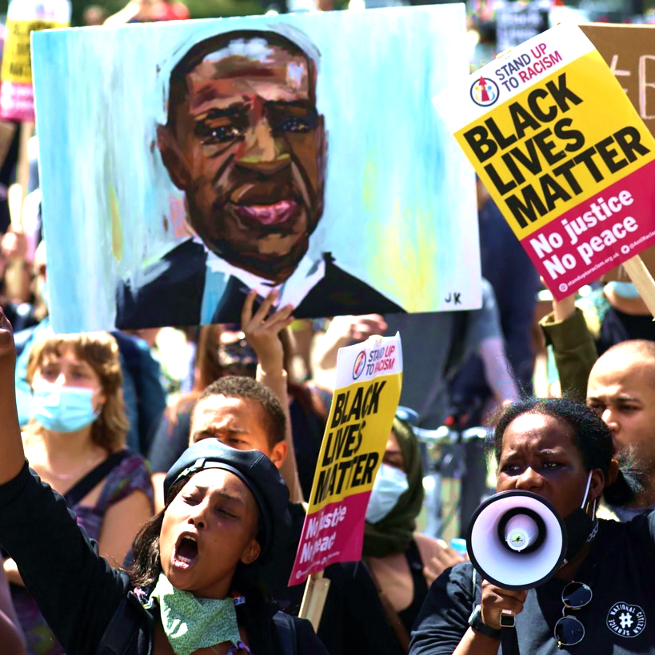
Ideology can be disrupted through attention to situated knowledge of the marginalized, investment in counter-publics, and participation in social movements that bring about epistemic and cultural paradigm shifts.
Public collective resistance
Supports (and undergirds?) elite (legislative, judicial, institutional) efforts to make formal changes;
Puts pressure on social norms and our terms of coordination;
Inspires individuals who want to change their personal relationships.

Slide 29
Return to our questions
How should we understand systemic, structural, institutional racism? What does it mean to say that injustice is systemic or structural? Are these different terms for the same thing?
How do systemic and structural racism “land upon the body”?
How might we address such racism? How might philosophy help?
Structural injustice occurs when the practices that create the network of positions and relations (a) distribute resources unjustly, (b) distort our understanding of what is valuable, or (c) organize us in ways that are unjust/harmful/wrong.
Systemic injustice occurs when an unjust structure is maintained in a complex system that its self-reinforcing, adaptive, and creates subjects whose identity is shaped to conform to it.
Subjects are interpellated to enact injustice and to bear it without complaint. Those who resist face coercion.
Participate in social movements that seek to change the structure of social relations by changing practices (both the cultural technē (including law) and material conditions).

Slide 30
Thanks for your attention!

Slide 31
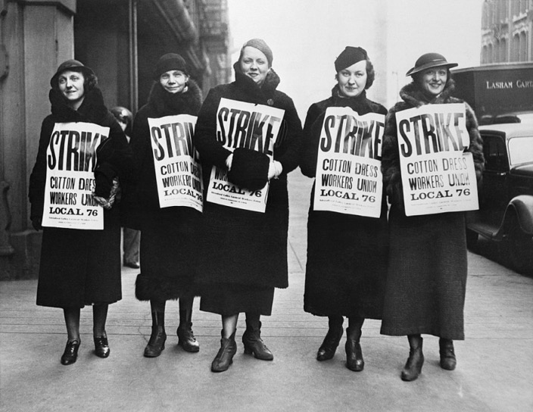
Social Movements
People unthinkingly conform to norms on the assumption that others will as well, so collective refusal to comply makes the norm available for reflection.
Resistance also reduces the motivation to continue conforming to the norm, since the norm is failing to provide a basis for coordination.
And if the resistance can claim a moral ground, then those who nevertheless continue to comply with the norm lose credibility, legitimacy, and status.
Activism disrupts coordination by changing the conditions within which the practice takes place: street demonstrations make it impossible for people to use roadways; strikes make it impossible for work to continue “as usual.”
But not all change in the material conditions need be as explicitly challenging, disruptive, or unruly. Small material and cultural changes matter.
Reason and argument does not always work. But….
”Between pure argument and violence is a wide range of contentious activities that are more or less disruptive of habitual ways of life, from petitioning, publicity campaigns, theatrical performances, candlelight vigils, litigation, and political campaigns to street demonstrations, boycotts, teach-ins, sit-ins, picketing, strikes, and building occupations.” Elizabeth Anderson (2014)
See: Elizabeth Anderson (2014)

